Slide 1
AWS CLOUD PRACTITIONER

Slide 2
Module 1
Cloud deployment types
You can deploy cloud resources in multiple ways: cloud, on-premises, and hybrid. Each type offers unique benefits and considerations, and exploring these options can help you make informed decisions about your cloud strategy. To learn more about cloud deployment types, choose each of the following flashcards.
Cloud
In a cloud-based deployment model, you have the flexibility to migrate your existing resources to the cloud, design and build new applications within the cloud environment, or use a combination of both.
For instance, a company might migrate data resources to the cloud, then develop an application comprised of virtual servers, databases, and networking components entirely hosted in the cloud.

Slide 3
On-premises
Deploying resources on premises using virtualization and resource management tools does not provide many of the benefits of cloud computing. However, it is sometimes sought for its ability to provide dedicated resources and low latency.
In most cases this deployment model is the same as legacy IT infrastructure while using application management and virtualization technologies to try increasing resource utilization.
Hybrid
In a hybrid deployment, cloud-based resources and on-premises infrastructure work together. This approach is ideal for situations where legacy applications must remain on premises due to maintenance preferences or regulatory requirements.
For instance, a company might choose to retain certain regulated legacy applications on-premises while using cloud services for advanced data processing and analytics.
Multi-cloud deployments can also be considered hybrid deployments.

Slide 4
Key benefits of the AWS Cloud
The six key benefits of the AWS Cloud are as follows.
Trade fixed expense for variable expense
By using the AWS Cloud, businesses can transition from fixed investments to variable costs. With variable costs, customer expenses are better aligned with actual usage, thus creating more financial flexibility.
Benefit from massive economies of scale
Like buying a product in bulk can result in lower prices per unit, the vast global infrastructure of AWS can result in lower costs for customers. This means that AWS can be used by many organizations, from small startups to major corporations. Businesses big and small can access advanced technologies that were previously only accessible to large enterprises.
Stop guessing capacity
Customers can dynamically scale AWS Cloud resources up or down based on real-time demand. This means businesses can achieve optimal performance without provisioning more or less infrastructure than they need.

Slide 5
Increase speed and agility
With the cloud, businesses can rapidly deploy applications and services, accelerating time to market and facilitating quicker responses to changing business needs and market conditions.
Stop spending money to run and maintain data centers
The AWS Cloud eliminates the need for businesses to invest in physical data centers. This means customers aren't required to spend time and money on utilities and ongoing maintenance. With AWS taking care of the physical infrastructure of the cloud, customer resources can be reallocated to more strategic initiatives.
Go global in minutes
Businesses don't need to set up their own infrastructure to expand internationally. AWS provides a robust global infrastructure that customers can use to deploy applications and services across multiple areas in minutes.

Slide 6
AWS Global Infrastructure
AWS Regions and Availability Zones
AWS Global Infrastructure consists of physical locations around the world that contain groups of data centers. To learn more about the design of AWS Regions and Availability Zones, choose each of the following two numbered markers.
AWS Regions
AWS Regions are physical locations around the world that contain groups of data centers. These groups of data centers are called Availability Zones. Each AWS Region consists of a minimum of three physically separate Availability Zones within a geographic area.
Availability Zones
An Availability Zone consists of one or more data centers with redundant power, networking, and connectivity. Regions and Availability Zones are designed to provide low-latency, fault-tolerant access to services for users within a given area.

Slide 7
Achieving high availability with AWS Global Infrastructure
AWS infrastructure is designed with high availability and fault tolerance in mind. Availability Zones (AZs) are configured as isolated resources, and they are each equipped with independent power, networking, and connectivity.
It's recommended to distribute your resources across multiple AZs. That way, if one AZ encounters an outage, your business applications will continue to operate without interruption. With this approach of redundancy and resource isolation, AWS customers can achieve the benefits of high availability and fault tolerance.

Slide 8
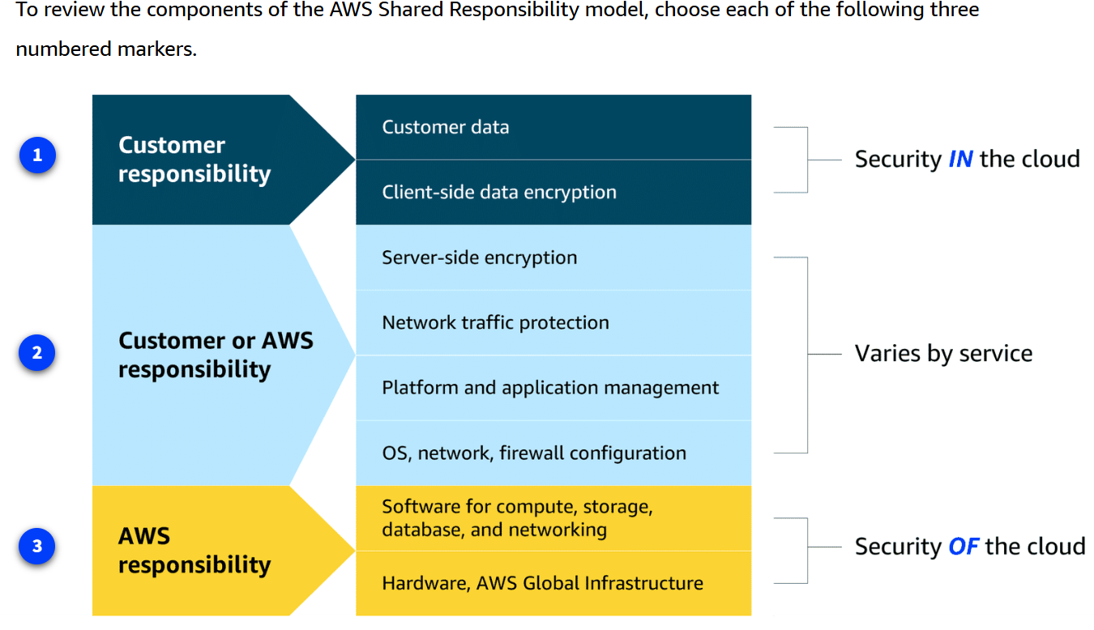
The AWS Shared Responsibility Model

Slide 9
Customer responsibilities
Customers are responsible for managing security requirements for their data, including which data they store on AWS and who has access to that data. Customers also control how access to the data is granted, managed, and revoked.
Additionally, customers are responsible for client-side encryption.
Shared responsibilities
Depending on the service used, responsibilities might shift between the customer and AWS. Components such as server-side encryption, network traffic protection, platform and application management, and OS, network, and firewall configuration vary by service in terms of who is responsible for these items. As you learn more about different types of services, you will see specific examples of how these elements are divided between the customer and AWS.
AWS responsibilities
AWS is responsible for protecting the infrastructure that runs all of the services offered in the AWS Cloud. This infrastructure is composed of the hardware, software, networking, and facilities that run AWS Cloud services.

Slide 10
Module 2
Intro to Amazon EC2
Q. What is compute?
Compute refers to the processing power needed to run applications, manage data, and perform calculations. In the cloud, this power is available on-demand. You can access it remotely without owning or maintaining physical hardware. Essentially, compute in the cloud means creating virtual machines with a cloud provider to run applications and tasks over the internet. In the following lessons, you will gain a thorough understanding of Amazon Elastic Compute Cloud (Amazon EC2), a powerful compute service from AWS, as you explore its flexibility, cost-effectiveness, and scalability.
Amazon EC2 is more flexible, cost-effective, and faster than managing on-premises servers. It offers on-demand compute capacity that can be quickly launched, scaled, and terminated, with costs based only on active usage.
The flexibility of Amazon EC2 allows for faster development and deployment of applications. You can launch as many or as few virtual servers as needed and configure security, networking, and storage. You can also scale resources up or down based on usage, such as handling high traffic or compute-heavy tasks.

Slide 11
Key takeaways: Comparing on-premises and cloud resources
When designing infrastructure for your business, selecting the right resources can significantly affect your efficiency, flexibility, and overall costs. Review the key differences between on-premises and cloud resource management.
Challenges of on-premises resources
Imagine that you're responsible for designing your company's infrastructure to support new websites. With traditional on-premises resources, you must purchase hardware upfront, wait for delivery, and handle installation and configuration. This process is time-consuming, costly, and inflexible because you're locked into a specific capacity that might not align with changing demands.
Benefits of using Cloud Resources
In contrast, with Amazon EC2, you can quickly launch, scale, and stop instances based on your needs without the delays and upfront costs associated with traditional on-premises resources.

Slide 12
How Amazon EC2 works
Launch an instance
When launching an EC2 instance, you start by selecting an Amazon Machine Image (AMI), which defines the operating system and might include additional software. You also choose an instance type, which determines the underlying hardware resources, such as CPU, memory, and network performance.
Connect to the instance
You can connect to an EC2 instance in various ways. Applications can interact with services running on the instance over the network.
Users or administrators can connect using SSH for Linux instances or Remote Desktop Protocol (RDP) for Windows instances. Alternatively, AWS services like AWS Systems Manager offer a secure and simplified method for accessing instances.
Use the instance
After you are connected to the instance, you can begin using it to run commands, install software, add storage, organize files, and perform other tasks.

Slide 13
EC2 instance types
Whether you're running a simple web service or complex data processing tasks, Amazon EC2 provides the flexibility to select the ideal instance type for your needs.
General purpose instances provide a balanced mix of compute, memory, and networking resources. They are ideal for diverse workloads, like web services, code repositories, and when workload performance is uncertain.
Compute optimized instances are ideal for compute-intensive tasks, such as gaming servers, high performance computing (HPC), machine learning, and scientific modeling.
Memory optimized instances are used for memory-intensive tasks like processing large datasets, data analytics, and databases. They provide fast performance for memory-heavy workloads.
Accelerated computing instances use hardware accelerators, like graphics processing units (GPUs), to efficiently handle tasks, such as floating-point calculations, graphics processing, and machine learning.
Storage optimized instances are designed for workloads that require high performance for locally stored data, such as large databases, data warehousing, and I/O-intensive applications.

Slide 14
Interacting with AWS services
All interactions with services are powered by APIs. You can access these APIs through three primary methods: the AWS Management Console, the AWS CLI, or the AWS SDK. Let's review these methods.
The AWS Management Console is a web interface for managing AWS services, offering quick access to services, search functionality, and simplified workflows. With the mobile app, you monitor resources, view alarms, and check billing, supporting multiple logged-in identities at once.
Good for: Users who prefer a visual, easy-to-use interface for managing and configuring AWS services
With the AWS CLI, you manage multiple AWS services directly from the command line across Windows, macOS, and Linux. You can automate tasks through scripts, such as launching EC2 instances.
Good for: Advanced users and developers who need to automate tasks, script actions, and manage AWS resources efficiently from the command line
The AWS SDK simplifies integrating AWS services into your applications by providing APIs for various programming languages. AWS offers documentation and sample code for languages like C++, Java, and .NET to help you get started.
Good for: Developers looking to integrate AWS services into their applications using language-specific APIs

Slide 15
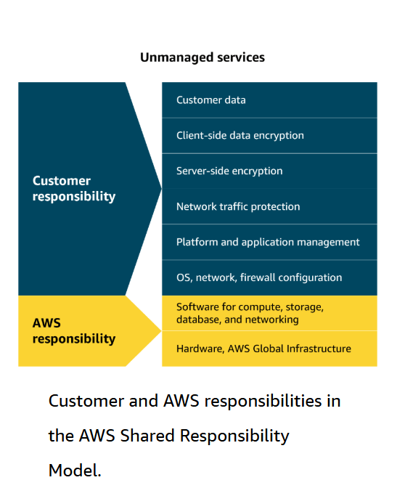
Compute and shared responsibility
The AWS Shared Responsibility Model outlines the division of duties between the customer and AWS. AWS handles the security of the cloud (hardware and infrastructure), whereas the customer is responsible for security in the cloud (applications, data, and access control).
An unmanaged service like Amazon EC2 requires you to perform all of the necessary security configuration and management tasks. When you deploy an EC2 instance, you are responsible for configuring security, managing the guest operating system (OS), applying updates, and setting up firewalls (security groups). You will learn more about managed and unmanaged services later.

Slide 16
Amazon Machine Images
In the demo, you got a quick introduction to AMIs. AMIs are pre-built virtual machine images that have the basic components for what is needed to start an instance. Now, let's explore AMIs in more detail.
AMI components
An AMI includes the operating system, storage setup, architecture type, permissions for launching, and any extra software that is already installed. You can use one AMI to launch several EC2 instances that all have the same setup.
Three ways to use AMIs
AMIs can be used in three ways. First, you can create your own by building a custom AMI with specific configurations and software tailored to your needs. Second, you can use pre-configured AWS AMIs, which are set up for common operating systems and software. Lastly, you can purchase AMIs from the AWS Marketplace, where third-party vendors offer specialized software designed for specific use cases.
AMI repeatability
AMIs provide repeatability through a consistent environment for every new instance. Because configurations are identical and deployments automated, development and testing environments are consistent. This helps when scaling, reduces errors, and streamlines managing large-scale environments.

Slide 17
AWS pricing options
By understanding the different Amazon EC2 pricing options, you can make more informed decisions and optimize your costs based on your specific usage needs. To review the AWS pricing options, choose each of the following flashcards.
On-Demand Instances:
Pay only for the compute capacity you consume with no upfront payments or long-term commitments required.
Click to flip
Reserved Instances:
Get a savings of up to 75 percent by committing to a 1-year or 3-year term for predictable workloads using specific instance families and AWS Regions.
Click to flip
Spot Instances:
Bid on spare compute capacity at up to 90 percent off the On-Demand price, with the flexibility to be interrupted when AWS reclaims the instance.
Click to flip
Savings Plans:
Save up to 72 percent across a variety of instance types and services by committing to a consistent usage level for 1 or 3 years.
Dedicated Hosts:
Reserve an entire physical server for your exclusive use. This option offers full control and is ideal for workloads with strict security or licensing needs.
Click to flip
Dedicated Instances:
Pay for instances running on hardware dedicated solely to your account. This option provides isolation from other AWS customers.

Slide 18
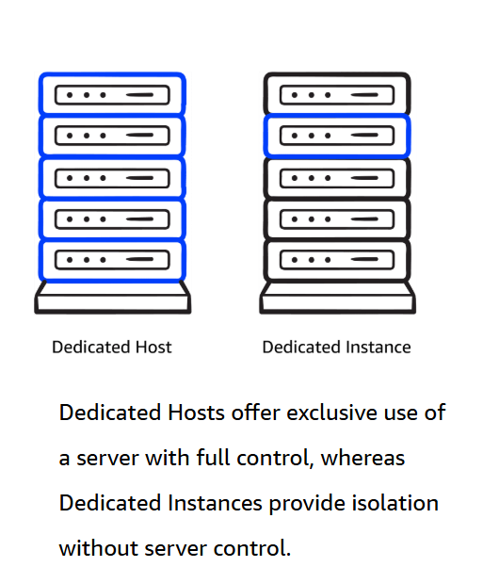
Dedicated Instances
Dedicated Hosts provide exclusive use of physical servers, offering full control over instance placement and resource allocation. This makes them ideal for security- or compliance-driven workloads. But what if you don’t need that level of control?
You could use Dedicated Instances, which offer physical isolation from other AWS accounts while still benefiting from the flexibility and cost savings of shared infrastructure.
The key difference is that Dedicated Instances provide isolation without you choosing which physical server they run on. Dedicated Hosts give you an entire physical server for exclusive use, providing complete control over instance placement and resource allocation.
Ultimately, the right choice depends on your specific workload requirements and the level of control you need over your infrastructure.

Slide 19
More about cost optimization
To optimize costs and resource allocation, AWS offers a range of pricing options including Savings Plans, Amazon EC2 Capacity Reservations, and Reserved Instances (RIs). Each of these is tailored to meet different workload and capacity needs.
Savings Plans
Good for: Predictable workloads
Savings Plans offer discounts compared to On-Demand rates in exchange for a commitment to use a specified amount of compute power (measured per hour) over a one-year or three-year period. They provide flexible pricing for Amazon EC2, AWS Fargate, AWS Lambda, and Amazon SageMaker AI usage, regardless of instance type or AWS Region. Payment options include All upfront, Partial upfront, or No upfront.
Capacity Reservations
Good for: Critical workloads with strict capacity requirements
With Amazon EC2 Capacity Reservations, you reserve compute capacity in a specific Availability Zone for critical workloads. Reservations are charged at the On-Demand rate, whether used or not. You only pay for the instances you run. This is ideal for strict capacity requirements for current or future business-critical workloads.
Reserved Instance flexibility
Good for: Steady-state workloads with predictable usage
RIs offer up to 75 percent savings over On-Demand pricing by applying discounts across instance sizes and multiple Availability Zones within a Region. When you purchase a Reserved Instance (RI), AWS automatically applies the discount to other instance sizes within the same family based on the instance size footprint. It also applies the discount across multiple Availability Zones for enhanced resource distribution and fault tolerance.

Slide 20
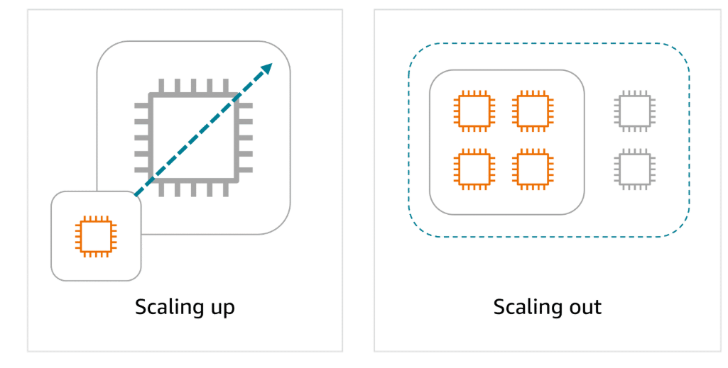
Scaling on EC2
Scalability is about a system’s potential to grow over time, whereas elasticity is about the dynamic, on-demand adjustment of resources.
Scalability
Scalability refers to the ability of a system to handle an increased load by adding resources. You can scale up by adding more power to existing machines, or you can scale out by adding more machines. Scalability focuses on long-term capacity planning to make sure that the system can grow and accommodate more users or workloads as needed.
Elasticity
Elasticity is the ability to automatically scale resources up or down in response to real-time demand. A system can then rapidly adjust its resources, scaling out during periods of high demand and scaling in when the demand decreases. Elasticity provides cost efficiency and optimal resource usage at any given moment.

Slide 21

Amazon EC2 Auto Scaling
Amazon EC2 Auto Scaling automatically adjusts the number of EC2 instances based on changes in application demand, providing better availability. It offers two approaches. Dynamic scaling adjusts in real time to fluctuations in demand. Predictive scaling preemptively schedules the right number of instances based on anticipated demand.
Example: Amazon EC2 Auto Scaling
With EC2 Auto Scaling, you maintain the desired amount of compute capacity for your application by dynamically adjusting the number of EC2 instances based on demand. You can create Auto Scaling groups, which are collections of EC2 instances that can scale in or out to meet your application’s needs.
An Auto Scaling group is configured with the following three key settings:
The minimum capacity defines the least number of EC2 instances required to keep the application running. This makes sure that the system never scales below this threshold. It's the number of EC2 instances that launch immediately after you have created the Auto Scaling group.
The desired capacity is the ideal number of instances needed to handle the current workload, which Auto Scaling aims to maintain. If you do not specify the desired number of EC2 instances in an Auto Scaling group, the desired capacity defaults to your minimum capacity.
The maximum capacity sets an upper limit on the number of instances that can be launched, preventing over-scaling and controlling costs. For example, you might configure the Auto Scaling group to scale out in response to increased demand.

Slide 22

Elastic Load Balancing
Elastic Load Balancing (ELB) automatically distributes incoming application traffic across multiple resources, such as EC2 instances, to optimize performance and reliability. A load balancer serves as the single point of contact for all incoming web traffic to an Auto Scaling group. As the number of EC2 instances fluctuates in response to traffic demands, incoming requests are first directed to the load balancer. From there, the traffic is distributed evenly across the available instances.
Although ELB and Amazon EC2 Auto Scaling are distinct services, they work in tandem to enhance application performance and ensure high availability. Together, they enable applications running on Amazon EC2 to scale effectively while maintaining consistent performance.
ELB benefits
Efficient traffic distribution:
ELB evenly distributes traffic across EC2 instances, preventing overload on any single instance and optimizing resource utilization.
Automatic scaling:
ELB scales with traffic and automatically adjusts to changes in demand for a seamless operation as backend instances are added or removed.
Simplified management:
ELB decouples front-end and backend tiers and reduces manual synchronization. It also handles maintenance, updates, and failover to ease operational overhead.

Slide 23
Routing methods
To optimize traffic distribution, ELB uses several routing methods: Round Robin, Least Connections, IP Hash, and Least Response Time. These routing strategies work together for efficient traffic management and optimal application performance.
Round Robin
Distributes traffic evenly across all available servers in a cyclic manner.
Least Connections
Routes traffic to the server with the fewest active connections, maintaining a balanced load.
IP Hash
Uses the client’s IP address to consistently route traffic to the same server.
Least Response Time
Directs traffic to the server with the fastest response time, minimizing latency.

Slide 24
Elastic Load Balancing
Let's look at an example to better understand how Elastic Load Balancing works in cloud computing. In the healthcare industry, particularly in hospitals and medical facilities that provide online appointment booking systems or patient portals, website traffic can vary greatly throughout the day.
Low-demand period: At the beginning of the day, only a few patients are accessing the system to book appointments or view medical records. The existing web servers are sufficient to handle the low traffic. This matches the demand, with no need for additional resources at this point.
High-demand period: As the day progresses, especially during peak hours, such as early mornings or just before the weekend, more patients access the portal to book appointments, view test results, or contact medical professionals. To handle this surge in demand, the healthcare system automatically scales up the number of servers to help ensure that the system remains responsive and available for all users.
A load balancer directs the incoming traffic to different web servers based on their current load. For instance, if one server starts receiving too many requests, the load balancer will route new requests to a less busy server. This makes sure that no single server becomes overwhelmed. The traffic is evenly distributed across available EC2 instances.

Slide 25
Decoupling services
In modern application development, reliability and resilience are important. One effective way to achieve this is by adopting a service-oriented approach.
Monolithic applications
Applications consist of multiple components that work together to transmit data, fulfill requests, and keep the application running smoothly. In a traditional approach to application architecture, the components—such as database logic, web application servers, user interfaces, and business logic—are tightly coupled. This means that if one component fails, it can cause the failure of other components, potentially bringing down the entire application.
Microservices architecture
To improve application availability and resilience, you can adopt a microservices architecture. In this approach, application components are loosely coupled, meaning that if one component fails, the others continue to function normally. The communication between components remains intact, and the failure of a single component does not impact the entire system. This design promotes greater flexibility and reliability in the application.
Supporting scalable and reliable cloud communication
Amazon EventBridge, Amazon SNS, and Amazon SQS are AWS services that help different parts of an application communicate effectively in the cloud. These services support building event-driven and message-based systems. Together, they help create scalable, reliable applications that can handle high traffic and can enhance communication between components.

Slide 26

EventBridge
EventBridge is a serverless service that helps connect different parts of an application using events, helping to build scalable, event-driven systems. With EventBridge, you route events from sources like custom apps, AWS services, and third-party software to other applications. EventBridge simplifies the process of receiving, filtering, transforming, and delivering events, so you can quickly build reliable applications.
Example: EventBridge
Customers use an online food delivery service to order meals from local restaurants through a mobile app. When a customer places an order, several steps need to happen simultaneously.
Payment processing The payment service must verify and process the customer's payment.
Restaurant notification The restaurant receives a notification to start preparing the meal.
Inventory management The inventory system checks if the ingredients for the order are available.
Delivery dispatch A delivery driver is notified to pick up and deliver the meal.
How EventBridge helps: EventBridge can route events, like order placed or payment completed, to the relevant services (payment, restaurant, inventory, and delivery). It can handle high volumes of events during peak times, making sure each service works independently. Even if one service fails, EventBridge will store the event and process it as soon as the service is available again. EventBridge helps provide a smooth and reliable operation across the entire system.

Slide 27

Amazon SQS
Amazon SQS is a message queuing service that facilitates reliable communication between software components. It can send, store, and receive messages at any scale, making sure messages are not lost and that other services don't need to be available for processing. In Amazon SQS, an application places messages into a queue, and a user or service retrieves the message, processes it, and then removes it from the queue.
Example: Amazon SQS
As customer support teams grow and the volume of issues increases, traditional workflows can struggle to keep up. Let's consider how a customer support team might tackle this challenge.
Scenario: A customer support team consists of a support agent and a technical specialist. The support agent is responsible for receiving customer issues, and the technical specialist works on resolving them. This process works well as long as both the agent and specialist are available and coordinated.
Challenge: However, what happens if the support agent creates a ticket but the technical specialist is busy working on another issue or unavailable? The agent would have to wait until the specialist is free to accept the new ticket, causing delays in resolving customer issues and extending wait times for customers. As the volume of customer issues increases, this process becomes inefficient.
Solution: To improve efficiency, they implement a queue system using Amazon SQS. The support agent adds customer issues to the queue, creating a backlog. Even if the specialist is busy, the agent can continue adding new issues. The specialist checks the queue, resolves issues, and updates the agent. This system provides a smooth workflow and helps handle higher volumes without delays or bottlenecks.

Slide 28

Amazon SNS
Amazon SNS is a publish-subscribe service that publishers use to send messages to subscribers through SNS topics. In Amazon SNS, subscribers can include web servers, email addresses, Lambda functions, and various other endpoints. You will learn about Lambda in more detail later.
Example: Amazon SNS
A company that sells a variety of products is currently sending a single email to all customers with updates on various topics, such as new products, special offers, and upcoming events. Although this method worked initially, customers want to receive only the updates they’re interested in. The current email update is causing customer dissatisfaction and lower engagement.
Segment the communication
The company decides to divide the communication into three separate topics, including one for new products, one for special offers, and one for events. Each topic will focus on a specific area of interest.
Let customers choose topics
Customers can subscribe to the topics they care about, such as the following:
A customer might subscribe only to new product updates.
Another customer might opt only for event notifications.
A third customer might choose to subscribe to new product updates and special offers.
Send tailored notifications
With Amazon SNS, the company can send personalized notifications to subscribers based on their specific interests. Amazon SNS makes sure that these notifications are promptly delivered to the right audience, improving the efficiency and relevance of the communication.

Slide 29
Module 3:
Unmanaged and managed services
AWS offers both unmanaged and managed services to suit different levels of control and responsibility. By understanding this model, you will know which tasks AWS manages and which you are responsible for, helping you secure and manage your cloud resources effectively.
Unmanaged and managed services
With unmanaged compute services like Amazon EC2, AWS takes care of the underlying physical infrastructure, but you're responsible for setting up, securing, and maintaining the operating system, network configurations, and applications on your instances. Managed services, on the other hand, reduce the amount of infrastructure you need to manage. While AWS handles much of the operational overhead, you might still need to perform some provisioning or configuration depending on the service.
Fully-managed services
Fully-managed services—like serverless ones—take abstraction even further, eliminating the need to provision or manage any servers at all. The underlying infrastructure is fully managed by AWS, so you can focus entirely on writing and deploying code. Later in this module, you will explore Lambda. Lambda is a serverless compute service where AWS handles the infrastructure, scaling, and availability, while you remain responsible for securing and managing your application code.

Slide 30
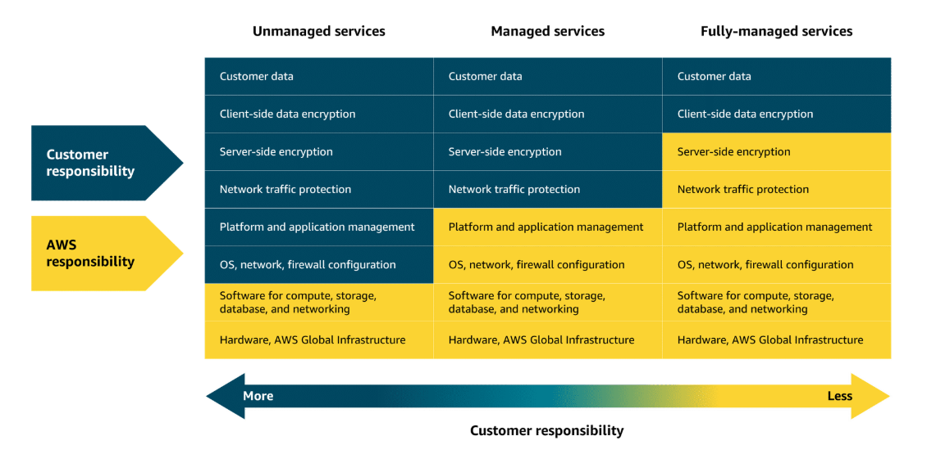

Slide 31
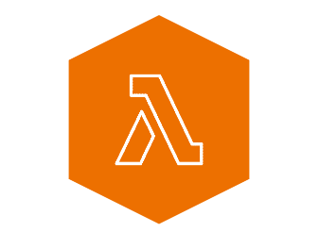
Lambda
Lambda is a serverless compute service that runs code in response to events without the need to provision or manage servers. It automatically manages the underlying infrastructure, scaling resources based on the volume of requests. You are charged only for the compute time consumed, down to the millisecond. Lambda handles execution, scaling, and resource allocation. You can optimize performance by configuring the appropriate memory size for your function.
How Lambda works
First, upload the code to Lambda, which uploads as a Lambda function.
Next, configure your code to be triggered by events, like AWS services, mobile apps, or HTTP requests.
Your code runs only when an event occurs, like a file upload or user action. Lambda automatically handles all the server management, scaling, and infrastructure. The Lambda runtime executes your function code using the event data passed to it. This way, your code runs reliably, securely, and efficiently—without you managing the servers or environment it runs in.
You are charged only for the compute time consumed, down to the millisecond. The price depends on the amount of memory that you allocate to your function.

Slide 32
Lambda use cases
Lambda is ideal for building responsive, event-driven applications across a wide range of industries. Here are three real-world examples that show how Lambda helps companies scale efficiently, reduce operational overhead, and only pay for what they use.
Real-time image processing for a social media application
A social media company uses Lambda to process images uploaded by users. When a photo is uploaded, Lambda is triggered to resize the image, apply filters, and save it in an optimized format to storage. This event-driven, serverless approach makes sure that the application can handle high volumes of uploads without needing to manage infrastructure.
Why Lambda: It automatically scales based on uploads and charges only for the time spent processing each image.
Personalized content delivery for a news aggregator
A news aggregator uses Lambda to fetch and process news articles from multiple sources, then it tailors recommendations based on user preferences. When a user opens the application or performs a search, Lambda functions are triggered to retrieve data, run personalization logic, and return relevant content.
Why Lambda: It automatically scales with user traffic and reduces costs by running code only when users interact.
Real-time event handling for an online game
A gaming company uses Lambda to handle in-game events like player actions, game state changes, and real-time leader board updates. Each event (like scoring a point or unlocking an achievement) triggers a Lambda function that updates player data and game status.
Why Lambda: It handles thousands of events, in real-time, with no need to manage servers. Costs scale with usage, which is ideal for peak gaming times.

Slide 33
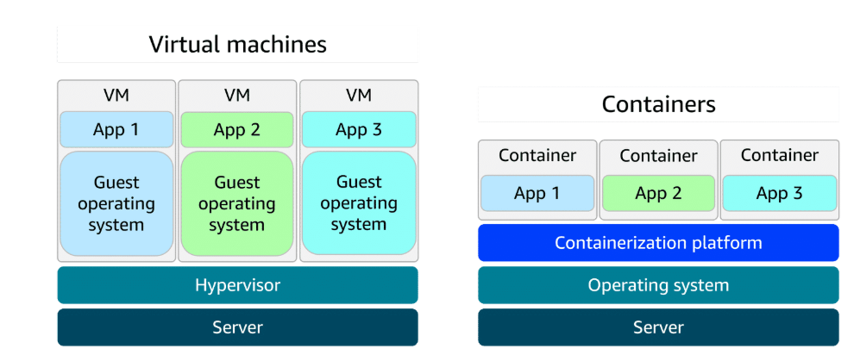
Solving deployment challenges
Containers provide a reliable way to package your application’s code and dependencies into a single, portable unit, making them ideal for workflows that require high security, reliability, and scalability.
Containers and VMs
A container packages your application with everything it needs to run, so it works the same on any computer. This helps to move, update, and manage. Containers are faster and lighter than virtual machines (VMs) because they share the host computer’s operating system. VMs use a hypervisor to run full, separate operating systems, which makes them less resource-efficient and have longer startup times.

Slide 34
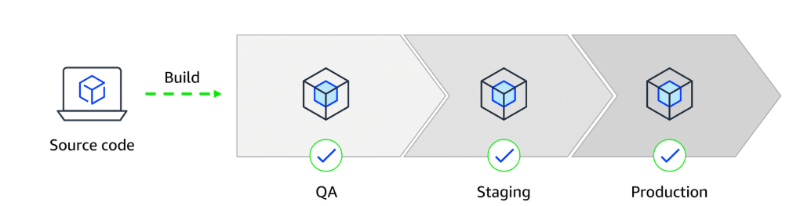
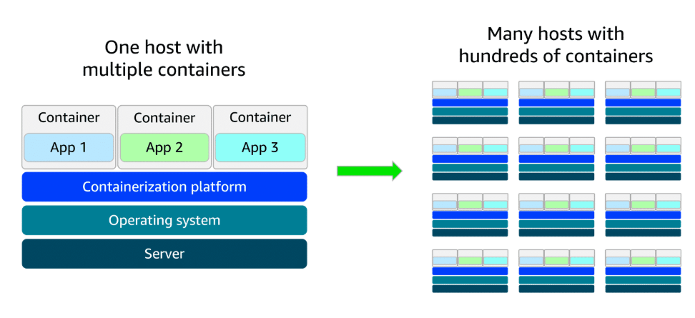
Deployment consistency with containers
When a developer’s environment differs from staging or production, deployments can fail and become difficult to debug. Containers solve this by keeping the application’s environment consistent everywhere, making deployments smoother and assisting troubleshooting.
Scaling containers with orchestration
As containerized applications scale, managing them becomes more complex. A setup that began with a few containers on a single host can quickly grow into hundreds or thousands of containers across multiple hosts. At that scale, manually handling container lifecycle, monitoring, and general operations becomes unsustainable. This is where orchestration tools come in. They automate deployment, scaling, and management to keep everything running smoothly.

Slide 35
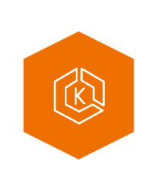
AWS container services
AWS has a set of tools for managing containers that fits into three categories: orchestration, registry, and compute.
Amazon EKS launch types
Amazon EKS with Amazon EC2: This is best for enterprises needing full control over infrastructure. It offers deep customization of EC2 instances alongside Kubernetes scalability—ideal for complex, large-scale workloads. Amazon EKS with AWS Fargate: This is great for teams wanting Kubernetes flexibility without managing servers. It combines Kubernetes power with serverless simplicity, helping to scale applications quickly across various use cases.
Amazon Elastic Kubernetes Service (Amazon EKS) is a fully managed service for running Kubernetes on AWS. It simplifies deploying, managing, and scaling containerized applications using open-source Kubernetes, with ongoing support and updates from the broader community.

Slide 36

Amazon ECS launch types
Amazon ECS with Amazon EC2 is ideal for small-to-medium businesses that need full control over infrastructure. Suitable for custom applications requiring specific hardware or networking configurations, with the flexibility of Amazon EC2 and the simplicity of Amazon ECS. Amazon ECS with AWS Fargate is perfect for startups or small teams building web applications with variable traffic. It's a serverless option—no server management required—so teams can focus on development while Amazon ECS handles scaling and orchestration.
Amazon ECS
Amazon Elastic Container Service (Amazon ECS) is a scalable container orchestration service for running and managing containers on AWS, like Docker containers. Docker is a software platform for building, testing, and deploying applications quickly.

Slide 37


Amazon ECR
Amazon Elastic Container Registry (Amazon ECR) is where you can store, manage, and deploy container images. It supports container images that follow the Open Container Initiative (OCI) standards. You can push, pull, and manage images in your Amazon ECR repositories using standard container tooling and command line interfaces (CLIs).
Fargate
AWS Fargate is a serverless compute engine for containers. It works with both Amazon ECS and Amazon EKS. Fargate is a container hosting platform, unlike Amazon ECS and Amazon EKS, which are both container orchestration services.
When using Fargate, you do not need to provision or manage servers. Fargate manages your server infrastructure for you. You can focus more on innovating and developing your applications, and you pay only for the resources that are required to run your containers.

Slide 38


Additional compute services
AWS offers purpose-built services for specific needs, such as streamlining web application deployment, managing batch workloads, providing virtual servers, and extending cloud infrastructure to on-premises data centers.
Elastic Beanstalk
Elastic Beanstalk is a fully managed service that streamlines the deployment, management, and scaling of web applications. Developers can upload their code, and Elastic Beanstalk automatically handles the provisioning of infrastructure, scaling, load balancing, and application health monitoring. It supports various programming languages and frameworks, such as Java, .NET, Python, Node.js, Docker, and more. It provides full control over the underlying AWS resources while automating many operational tasks.
Good for: Deploying and managing web applications, RESTful APIs, mobile backend services, and microservices architectures, with automated scaling and simplified infrastructure management
AWS Batch
AWS Batch is a fully managed service that you can use to run batch computing workloads on AWS. It automatically schedules, manages, and scales compute resources for batch jobs, optimizing resource allocation based on job requirements.
Good for: Processing large-scale, parallel workloads in areas like scientific computing, financial risk analysis, media transcoding, big data processing, machine learning training, and genomics research

Slide 39


Lightsail
Amazon Lightsail is a cloud service offering virtual private servers (VPSs), storage, databases, and networking at a predictable monthly price. It’s ideal for small businesses, basic workloads, and developers seeking a straightforward AWS experience without the complexity of the full AWS Management Console.
Good for: Basic web applications, low-traffic websites, development and testing environments, small business websites, blogs, and learning cloud services
Outposts
AWS Outposts is a fully managed hybrid cloud solution that extends AWS infrastructure and services to on-premises data centers. It provides a consistent experience between on premises and the AWS Cloud, offering compute, storage, and networking components.
Good for: Low-latency applications, data processing in remote locations, migrating and modernizing legacy applications, and meeting regulatory compliance or data residency requirements

Slide 40
Module 4: Going Global with AWS infrastructure
How to choose a Region or set of Regions
If we were to expand our coffee shop by opening new locations, there would be multiple things to consider, like customer demand and development cost. Similarly, you have several factors to consider when selecting a Region or set of Regions for your real-life resources.
AWS edge locations
Like our coffee franchise could expand with smaller versions of the shop such as mobile coffee carts, AWS has smaller footprint facilities called edge locations. Edge locations cache items like images, videos, and other resources, so that users can access the content they need with lower latency.
Infrastructure as code and CloudFormation
Another important consideration of a coffee shop expansion would be to maintain a consistent product from location to location. AWS has services, such as CloudFormation, that you can use to help automate the deployment of your cloud resources. These services use infrastructure as code, or IaC, helping you achieve a consistent, reliable set up each time your business grows.

Slide 41
Key considerations when choosing Regions
Compliance
Compliance is an important consideration when selecting Regions for deploying business resources. Different geographical locations have varying regulatory requirements and data protection laws that organizations must follow. For example, the General Data Protection Regulation (GDPR) is designed to protect the personal data and privacy of individuals within the European Union (EU). An online retail company operating in the EU would be required to meet GDPR compliance to protect customer data. GDPR compliance includes obtaining proper consent for data collection and providing mechanisms for data access and deletion.
Proximity
When selecting a Region, you also want to consider how to achieve low latency for your users. Regions closer to your user base minimize data travel time, which reduces latency and enhances application responsiveness. Choosing a Region or set of Regions farther away from customers could introduce delays, which might impact user satisfaction and overall system efficiency.
Feature availability
You also want to consider which specific features and services are available in each Region. AWS is constantly expanding features and services to multiple locations, but not all Regions contain all AWS offerings. For example, AWS GovCloud Regions are specifically designed to meet the compliance and security requirements of US government agencies and their contractors. These Regions have stringent physical, operational, and personnel security controls in place. These controls are only available in specific Regions to meet certain governmental regulatory requirements.
Pricing
When selecting a Region, pricing is also a factor that can influence your decision. Some Regions have lower operational costs than others. These operational costs can impact the overall expenses for hosting applications and services. Tax laws and regulations can also play a role in cost. Some Regions might offer tax incentives or have lower tax rates, which can affect customer pricing. Additionally, data sovereignty laws in certain Regions might require data to be stored locally, affecting both compliance and cost.

Slide 42
Designing highly available architectures
Deploying multi-Region and multi-AZ resources
You've learned how deploying your cloud resources to multiple Regions can achieve high availability. In addition to deploying to multiple Regions, you also want to deploy resources to multiple Availability Zones. By building redundant architectures or replicating your resources across multiple levels of AWS infrastructure, you can improve application reliability so that your users have access to your content when they need it.
In addition to high availability, the AWS Global Infrastructure also helps you achieve agility and elasticity for your business. Let's discuss the difference between these advantages:
High availability: High availability refers to the capability of a system to operate continuously without failing. In the context of AWS infrastructure, it means that your applications can handle the failure of individual components without significant downtime.
Agility: Agility refers to the ability to quickly adapt to changing requirements or market conditions. With AWS infrastructure in place, you can modify and deploy services rapidly.
Elasticity: Elasticity refers to the ability of a system to scale resources up or down automatically in response to changes in demand. AWS infrastructure is set up for you to scale resources up and down on demand.
Edge locations
In addition to AWS Regions that contain Availability Zones, AWS has a global edge network that provides quicker content access to users outside of standard Regions. These edge locations are strategically placed in areas like Atlanta, Georgia, USA or Shanghai, China to provide low-latency access to AWS services and content delivery. Edge locations offer multiple services to run closer to end users, including AWS networking services like Amazon CloudFront. CloudFront is a content delivery network (CDN) and caching system that you learn more about later in this training.

Slide 43
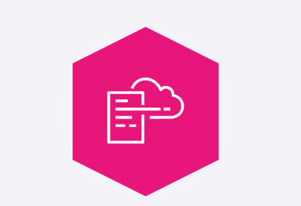
CloudFormation
CloudFormation is a service that helps you model and set up your AWS resources so that you can spend less time managing those resources and more time focusing on your applications that run in AWS. With CloudFormation, you can define your infrastructure as code. You create a template that describes all the AWS resources that you want (like Amazon Elastic Compute Cloud (Amazon EC2) instances), and CloudFormation takes care of provisioning and configuring those resources for you.
Interacting with AWS resources
As you've learned, there are a number of ways you can operate in the AWS Cloud. To interact with AWS resources, you must invoke AWS APIs. To interact with these APIs, you can use the AWS SDKs, the AWS Command Line Interface (AWS CLI), the AWS Management Console, or IaC tools such as CloudFormation.

Slide 44
Programmatic access Programmatic access includes options like the AWS CLI and AWS SDKs. These options are best suited for developers and those familiar with coding languages. With the AWS CLI, you manage multiple AWS services directly from the command line. You can automate tasks through scripts. AWS SDKs can help integrate AWS services into your applications by providing APIs for various programming languages. AWS provides documentation and sample code to help you get started with using SDKs.
Use cases for AWS CLI actions and SDKs include the following:
AWS CLI: Automate routine tasks. For example, you might write a script to provide routine backups for a service such as Amazon Elastic Block Store (Amazon EBS).
SDKs: Invoke APIs for one part of an application process. For example, you might use an SDK to store user data in an AWS storage service such as Amazon Simple Storage Service (Amazon S3).

Slide 45
AWS Management Console
The AWS Management Console is a web interface that you use for managing AWS services, offering quick access to services, search functionality, and simplified workflows. The console is a great option for those new to the cloud or users with minimal or no development experience.
Use cases for using the console include the following:
Billing and cost optimization dashboards and visualizations
Services focused on graphical representations, like Amazon QuickSight and Amazon Neptune
Infrastructure as Code
With IaC tools such as CloudFormation, you can automate resource management across your organization with AWS service integrations offering efficient and repeatable resource creation and management.
Use cases for CloudFormation include the following:
Managing infrastructure with DevOps such as continuous integration and delivery (CI/CD) pipelines
Scaling resources such as Amazon EC2 instances to multi-Region applications in a consistent, repeatable way

Slide 46
Module 5: Networking
The term networking refers to interconnected devices that can exchange data and resources. Networking in the AWS Cloud consists of the infrastructure and services working together to host your applications, data, and any other resources you might need. Let's get started and learn about the foundational network components used in the AWS Cloud.
Networking components
So far, you've learned about the AWS Cloud, AWS Regions, and Availability Zones. Now you will review two more foundational networking components you will use in the AWS Cloud.
Amazon Virtual Private Cloud (Amazon VPC)
An Amazon VPC lets you provision a logically isolated section of the AWS Cloud where you can launch AWS resources in a virtual network that you define.
Subnet
Subnets are used to organize your resources and can be made publicly or privately accessible. A private subnet is commonly used to contain resources like a database storing customer or transactional information. A public subnet is commonly used for resources like a customer-facing website.

Slide 47
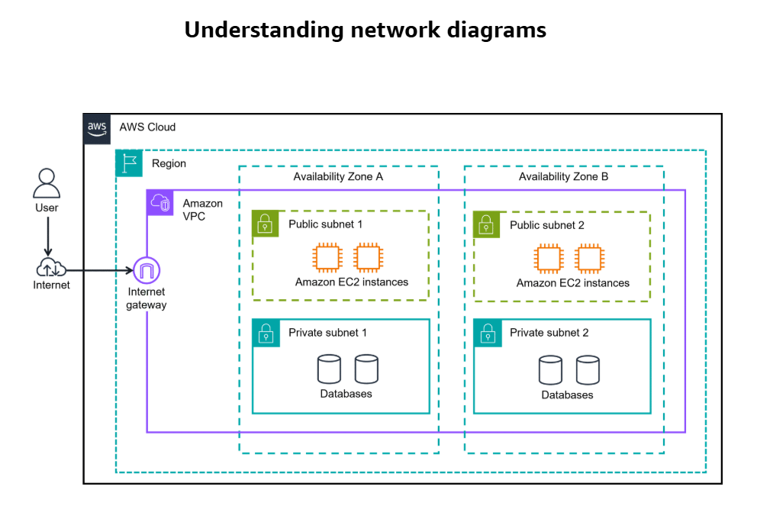
The AWS Cloud is the outermost box in most diagrams.
Region is the next box. AWS Regions are separate geographic areas. You choose your Region based on your users' geographic location for lower latency, compliance and data residency requirements, available services, and cost.
Amazon VPC is a solid box, and it represents your isolated, logically segmented network within AWS. A VPC helps you to control your network resources and security.
Availability Zones are shown as separate boxes across a region. AZs consist of one or more discrete data centers, each with redundant power, networking, and connectivity, and housed in separate facilities. Using multiple AZs can protect your applications from the failure of a single location in the Region.
Subnets are essentially segments of your VPC, allowing you to divide your VPC into smaller, manageable sections. A subnet is a range of IP addresses in your VPC.
Private subnets are designed to isolate resources that shouldn't be directly exposed to the public internet. In diagrams, they are illustrated with solid boxes.
Public subnets are designed to provide direct internet access to resources placed inside them. To allow access, they are connected with an internet gateway. You will learn more about internet gateways in a later lesson. In diagrams, public subnets are drawn with dashed boxes.

Slide 48

Organizing resources in the AWS Cloud
Imagine the millions of customers who use AWS services. Also imagine the millions of resources that these customers have created, such as Amazon EC2 instances. Without boundaries around all these resources, network traffic can flow between them unrestricted. In the following section you will learn about two components of the AWS Cloud.
Amazon Virtual Private Cloud (VPC)
Gateways to connect your resources
Establishing boundaries around AWS resources
When organizing your resources in the AWS Cloud, you need to be able to group certain functions together and isolate them from the public, or make them available to the public. You've been introduced to what Amazon VPCs do. Next, you will review the benefits.
Amazon VPC
With Amazon VPC, you can provision an isolated section of the AWS Cloud. In this isolated section, you can launch resources in a virtual network that you define. It provides three main benefits. It helps increase security because you can secure and monitor connections, screen traffic, and restrict instance access. Amazon VPC gives you full control over your resource placement, connectivity, and security. The convenience of using Amazon VPC means you will spend less time setting up, managing, and validating your virtual network when compared to on-premises network management.

Slide 49
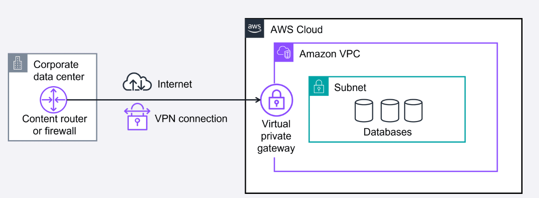
Subnets
Within an Amazon VPC, you can organize your resources into subsections or subnets. A subnet is a section of an Amazon VPC that can contain resources, such as Amazon EC2 instances. You will learn more about subnets in the next lesson.
Connecting your resources with an internet gateway
To allow public traffic from the internet to access your VPC, you attach an internet gateway to the VPC. An internet gateway is a connection between a VPC and the internet. You can think of an internet gateway as being similar to a doorway that customers use to enter the coffee shop. Without an internet gateway, no one can access the resources within your VPC.
Virtual private gateways
What if you have a VPC that includes only private resources? The following example shows how a virtual private gateway works. You can think of the internet as the road between your home and the coffee shop. It is open and accessible to anyone. You want a way to protect the traffic you send on the internet from the public, internet service providers, and others who might be trying to track or intercept it. This is where a virtual private network (VPN) connection comes in.
VPN creates a connection that is more like a secure tunnel through the internet. Using encryption, it hides and protects everything you send and receive from outside eyes. A virtual private gateway is the component in the AWS Cloud that makes it possible for you to connect this protected traffic to enter the VPC. With a VPN connection, your data travels privately and safely, hidden from others using the same route.
With a virtual private gateway, you can establish a VPN connection between your VPC and a private network, such as an on-premises data center or internal corporate network. A virtual private gateway allows traffic into the VPC only if it is coming from an approved network.

Slide 50
Several of the preceding networking components have similar abbreviations and are often confused. These components are core building blocks that you'll use in many AWS Cloud solutions.
Amazon Virtual Private Cloud
Amazon VPC is used to establish boundaries around your AWS resources.
Virtual private gateway
A virtual private gateway allows protected internet traffic to enter into the VPC.
Virtual private network
A VPN encrypts your internet traffic, helping protect it from anyone who might try to intercept or monitor it.

Slide 51
Connecting to the AWS Cloud
With so many different types of networks, on-premises datacenters, and remote workers, companies need a wide range of ways to connect to the AWS Cloud. In the following section, you will learn four ways to connect to the AWS Cloud:
AWS Client VPN
AWS Site-to-Site VPN
AWS PrivateLink
AWS Direct Connect
Securely connect a remote workforce to AWS Cloud resources
Imagine a company with a recent acquisition needing to securely connect their new remote workforce to their AWS Cloud resources. Even the largest companies with worldwide remote workers can quickly scale up and connect to the AWS Cloud. That's where AWS Client VPN can help.

Slide 52

AWS Client VPN
AWS Client VPN is a networking service you can use to connect your remote workers and on-premises networks to the cloud. It is a fully managed, elastic VPN service that automatically scales up or down based on user demand. Because it is a cloud VPN solution, you don’t need to install and manage hardware or try to estimate how many remote users to support at one time.
Benefits: AWS Client VPN provides advanced authentication, remote access. It is elastic and fully managed.
Use case: It can be used to quickly scale remote-worker access.
Client VPN, a managed VPN service, provides secure access to AWS resources and on-premises networks from anywhere. It uses an OpenVPN-based client, and it works with global Regions by using the AWS global network.

Slide 53

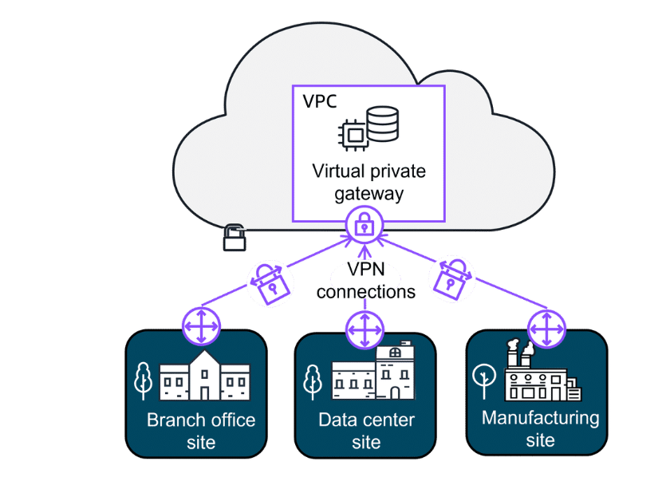
Securely connect sites to other sites
Some companies might want to establish secure, encrypted connections between their on-premises networks like data centers or branch offices and their resources in their Amazon VPC. That's where Site-to-Site VPN can help.
AWS Site-to-Site VPN
Site-to-Site VPN creates a secure connection between your data center or branch offices and your AWS Cloud resources.
Benefits: Site-to-Site VPN provides high availability, secure and private sessions, and accelerates applications.
Use cases: It can be used for application migration and secure communication between remote locations.

Slide 54
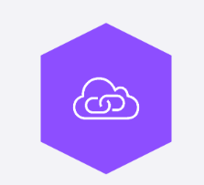
Securely connect resources, even in other VPCs
Other companies sometimes need the flexibility to privately connect to resources in other cloud providers as though they were in their own VPC. They need a way to communicate with these resources and don't want the hassle of setting up gateways or site-to-site VPNs. That's where AWS PrivateLink can help.
AWS PrivateLink
AWS PrivateLink is a highly available, scalable technology that you can use to privately connect your VPC to services and resources as if they were in your VPC. You do not need to use an internet gateway, NAT device, public IP address, Direct Connect connection, or AWS Site-to-Site VPN connection to allow communication with AWS services or resources from your private subnets. Instead, you control the specific API endpoints, sites, services, and resources that are reachable from your VPC.
Benefits: AWS PrivateLink helps you secure your traffic and connect with simplified management rules.
Use case: It is used for connecting your clients in your VPC to resources, other VPCs, and endpoints.
Even though the preceding connections are highly available and scalable, traffic jams are possible because you’re using the same connection as other clients. That's why for some use cases, you might need a dedicated private connection with a lot of bandwidth.

Slide 55

Dedicated private connections for increased bandwidth
AWS Direct Connect
Direct Connect is a service that makes it possible for you to establish a dedicated private connection between your network and VPC in the AWS Cloud.
Benefits: AWS Direct Connect reduces network costs and increases amount of bandwidth.
Latency-sensitive applications
Direct Connect bypasses the internet and provides a consistent, low-latency network experience. This makes it ideal for applications like video streaming and other real-time applications that require high performance.
Large-scale data migration or transfer
Direct Connect helps ensure smooth and reliable data transfers at massive scale for real-time analysis, rapid data backup, or broadcast media processing.
Hybrid cloud architectures
You can use Direct Connect to link your AWS and on-premises networks to build applications that span environments without compromising performance.

Slide 56
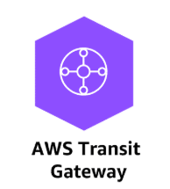
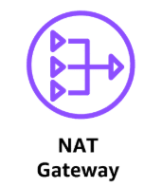
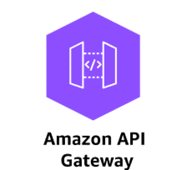
Additional gateway services
AWS Transit Gateway
AWS Transit Gateway is used to connect your Amazon VPCs and on-premises networks through a central hub. As your cloud infrastructure expands globally, inter-Region peering connects transit gateways together using the AWS Global Infrastructure.
Network Address Translation (NAT) Gateway
A NAT gateway is a NAT service. You can use a NAT gateway so that instances in a private subnet can connect to services outside your VPC but external services can't initiate a connection with those instances.
Amazon API Gateway
You learned about Application Programming Interface (API)s earlier. Quick refresher, an API defines how different software systems can interact and communicate with each other. The Amazon API Gateway is an AWS service for creating, publishing, maintaining, monitoring, and securing APIs at any scale.

Slide 57
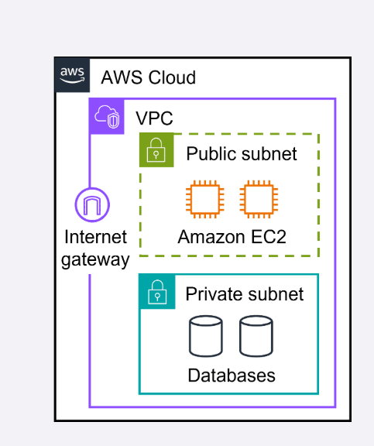
Subnets
A section of a VPC for grouping resources based on security or operational needs
A subnet is a section of a VPC in which you can group resources based on security or operational needs. Subnets can be public or private.
Public subnets contain resources that need to be accessible by the public, such as an online store’s website.
Private subnets contain resources that should be accessible only through your private network, such as a database that contains customers’ personal information and order histories.
In a VPC, you can define rules to allow resources in different subnets to communicate with each other. For example, you might have an application that uses Amazon EC2 instances in a public subnet communicating with databases that are located in a private subnet.
Network traffic in a VPC
The movement of data packets traveling across a network
When a customer requests data from an application hosted in the AWS Cloud, this request is sent as a packet. A packet is a unit of data sent over the internet or a network.
It enters into a VPC through an internet gateway. Before a packet can enter into a subnet or exit from a subnet, it will run into several checks for permissions, one being a network ACL associated with the subnet the packet is being routed to. The permissions defined by the network ACLs indicate what is allowed or denied. It is based on who sent the packet and how the packet is trying to communicate with the resources in a subnet.
The VPC component that checks packet permissions for subnets is a network ACL.

Slide 58
Network ACLs
Virtual firewall controlling traffic
A network ACL is a virtual firewall that controls inbound and outbound traffic at the subnet level.
For example, imagine that you are at the airport. Travelers are trying to enter into a different country. You can think of the travelers as packets and the passport control officer as a network ACL. The passport control officer checks travelers’ credentials when they are both entering and exiting the country. This is similar to how a network ACL checks permissions every time a packet travels across a subnet boundary.
Each AWS account includes a default network ACL. When configuring your VPC, you can use your account’s default network ACL or create custom network ACLs. By default, your account’s default network ACL allows all inbound and outbound traffic, but you can modify it by adding your own rules.
For custom network ACLs, all inbound and outbound traffic is denied until you add rules to specify which traffic to allow. Additionally, all network ACLs have an explicit deny rule. This rule makes sure that if a packet doesn’t match any of the other rules on the list, the packet is denied.
Stateless packet filtering
Network ACLs perform stateless packet filtering. They remember nothing and check packets that cross the subnet border each way: inbound and outbound.
Recall the previous example of a traveler who wants to enter into a different country. This is similar to sending a request out from an Amazon EC2 instance and to the internet.
When a packet response for that request comes back to the subnet, the network ACL does not remember your previous request. The network ACL checks the packet response against its list of rules to determine whether to allow or deny.

Slide 59
Security groups
Control inbound and outbound traffic at the resource level
After a packet has entered a subnet, it must have its permissions evaluated for resources within the subnet, such as Amazon EC2 instances. A security group is the VPC component that checks packet permissions for an Amazon EC2 instance. It is a virtual firewall that controls inbound and outbound traffic for specific AWS resources, like Amazon EC2 instances.
By default, a security group denies all inbound traffic and allows all outbound traffic. For this example, suppose that you are at an apartment building with a door attendant who greets guests at the door. You can think of the guests as packets and the door attendant as a security group. With the default settings, the security groups won't let anyone in and allows all outbound traffic out.
With security groups, you can add custom rules to configure which traffic should be allowed. Any other traffic would then be denied. For example, custom rules can be given separately for inbound and outbound traffic. As guests arrive, the door attendant checks a list to makes sure they can enter the building. However, the door attendant does not check the list again when guests are exiting the building.
Note: If you have multiple Amazon EC2 instances within the same VPC, you can associate them with the same security group or use different security groups for each instance.
Stateful packet filtering
Security groups perform stateful packet filtering. They remember previous decisions made for incoming packets.
Consider the same example of sending a request out from an Amazon EC2 instance to the internet. When a packet response for that request returns to the instance, the security group remembers your previous request. The security group allows the response to proceed, regardless of inbound security group rules.

Slide 60
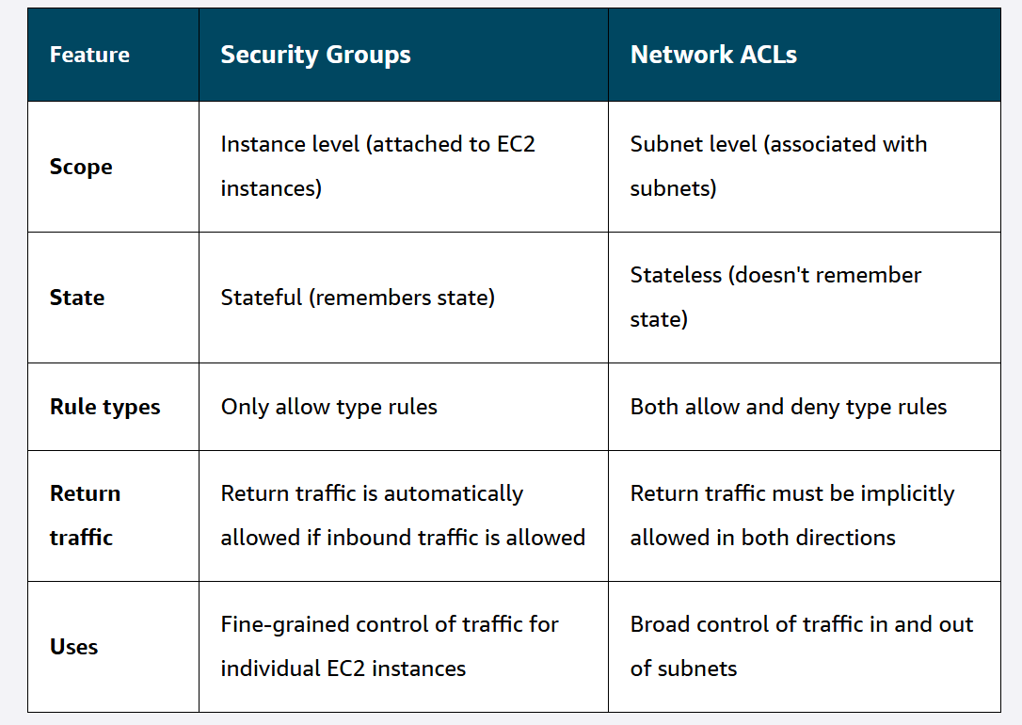
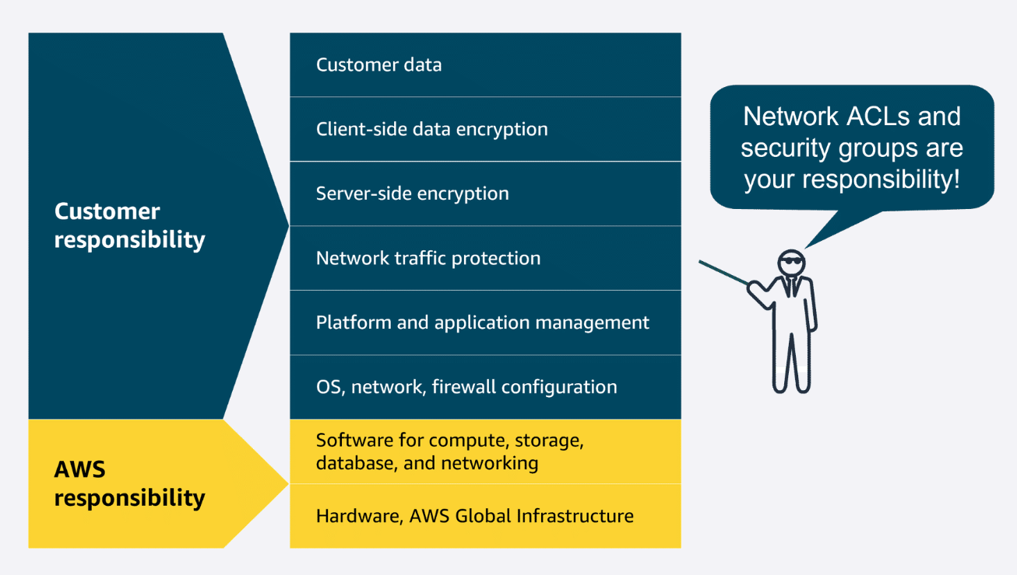
With both network ACLs and security groups, you can configure custom rules for the traffic in your VPC. As you continue to learn more about AWS security and networking, it is important to understand the differences between them. The following table will help you understand which to use.

Slide 61
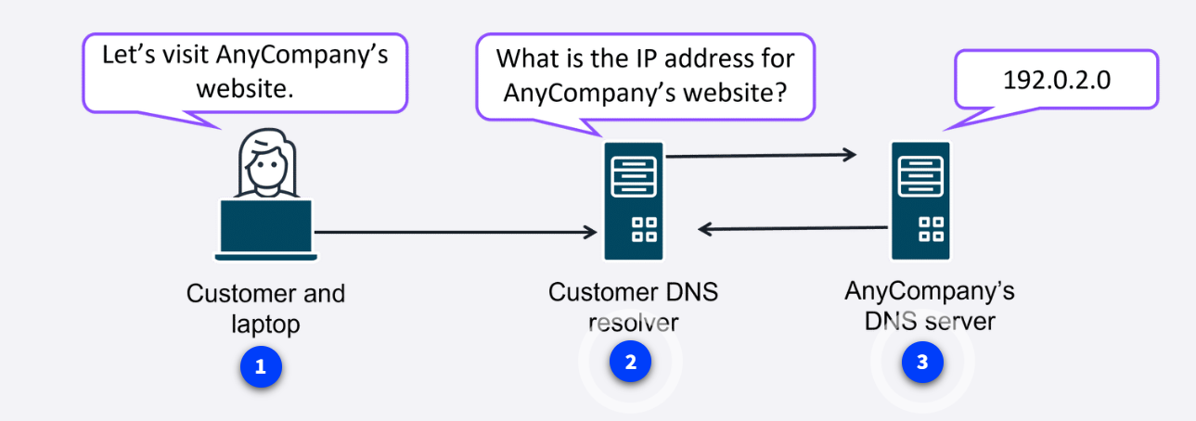
Edge networking services
Secure and speedy networking for user-facing application data
Edge networking is the process of bringing information storage and computing abilities closer to the devices that produce that information and the users who consume it. Edge computing is important because organizations often need lower latency access to their data and content. By performing tasks or caching data locally or closer to users, organizations can deliver faster, more responsive experiences while maintaining better control over their infrastructure. There are also many different services that are hosted on the edge, like the DNS service, Amazon Route 53.
Translating domain names to IP addresses with DNS
Suppose that AnyCompany has a website hosted in the AWS Cloud. Customers enter the web address into their browser and they are able to access the website. This happens because of DNS resolution. DNS resolution involves a customer DNS resolver communicating with a company DNS server.
You can think of DNS as being the phone book of the internet. DNS resolution is the process of translating a domain name to an IP address.
To learn more about how DNS works,
choose each of the three numbered markers.

Slide 62
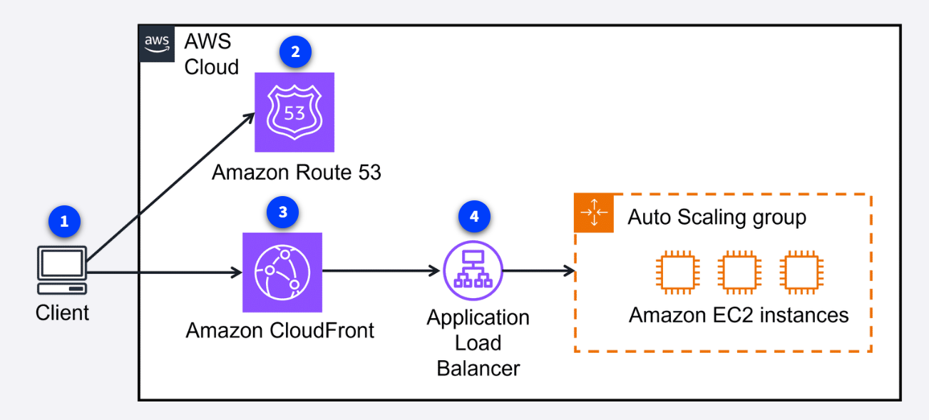


Amazon Route 53
Route 53 is a DNS that provides a reliable and cost-effective way to route end users to internet applications.
Route 53 directs end users to your resources with globally dispersed DNS servers and automatic scaling. It gives developers and businesses a reliable way to route end users to internet applications hosted in AWS. It connects user requests to infrastructure running in AWS, such as Amazon EC2 instances and load balancers. It also routes users to infrastructure outside of AWS.
Another feature of Route 53 is the ability to manage the DNS records for domain names. You can register new domain names directly in Route 53. You can also transfer DNS records for existing domain names managed by other domain registrars. This makes it possible for you to manage all of your domain names within a single location.
Route 53 also works with the next AWS edge networking service, Amazon CloudFront.
Amazon CloudFront
CloudFront is a content delivery network (CDN) service that delivers your content with faster loading times, cost savings, and reliability.
CloudFront is like a global network of delivery trucks that quickly brings web content to users around the world. Instead of all requests traveling back to one central warehouse (your original server), CloudFront stores copies of your content at locations closer to your users. This means websites, videos, images, and applications load much faster, no matter where your customers are located.
To learn more, expand each of the following three categories.

Slide 63

AWS Global Accelerator
Global Accelerator is a service that uses the AWS global network to improve application availability, performance, and security. It uses intelligent traffic routing and fast failover if something goes wrong in one of your application locations.
Global Accelerator is a networking service that helps your applications run faster and more reliably across the globe. Think of it like creating express lanes on the internet highway specifically for your application's traffic. Instead of your users' requests taking the regular, sometimes congested internet routes, Global Accelerator directs traffic through the AWS private global network—getting your users to your application faster and more reliably.

Slide 64
Module 6: Storage
Block storage
Block storage provides persistent, low-latency block-level storage volumes that attach to EC2 instances like physical hard drives. Block storage volumes can be encrypted, backed up via snapshots, and modified while in use without disrupting the instance. AWS offers two primary block storage services:
Amazon EC2 instance store
An unmanaged non-persistent, high-performance block storage directly attached to EC2 instances for temporary data.
Amazon Elastic Block Store (EBS)
A managed service that provides persistent block storage volumes for EC2 instances, offering various types for different workloads
Object storage
Object storage is a data storage architecture that manages data as objects in a flat address space. It offers unlimited scalability so you can store vast amounts of unstructured data without worrying about capacity constraints. Object storage provides enhanced metadata capabilities to provide more efficient data management, search, and analytics across massive datasets.
The following is the primary AWS object storage service:
Amazon Simple Storage Service (S3)
A fully managed scalable object storage service for storing and retrieving any amount of data from anywhere.

Slide 65
File storage
AWS file storage services provide shared file systems accessible over networks, so multiple users and applications can access the same data simultaneously. They offer scalability and flexibility so you can expand storage capacity as needs grow without managing physical infrastructure. AWS offers two primary file storage services:
Amazon Elastic File System (EFS)
A fully managed, scalable NFS file system for use with AWS Cloud services and on-premises resources.
Amazon FSx
A fully managed file storage services for popular file systems like Windows, Lustre, and NetApp ONTAP.
Additional storage services
These services don't fit cleanly into the categories we've defined so far, but they're important AWS storage offerings that you should be familiar with.
AWS Storage Gateway
A fully managed, hybrid-cloud storage service that provides on-premises access to virtually unlimited cloud storage.
AWS Elastic Disaster Recovery
A fully managed service that streamlines the recovery of your physical, virtual, and cloud-based servers into AWS.

Slide 66
AWS shared responsibility
AWS storage services
The AWS shared responsibility model groups services into three categories based on the ownership of administrative tasks. These categories are fully managed, managed, and unmanaged.
To learn more about how these categories relate to storage services, expand the following three categories.
Fully managed services
For fully managed storage services, AWS is responsible for everything from the hardware and infrastructure up through the entire storage stack. This includes data durability, availability, encryption at rest, and replication. Customers are only responsible for data management, access controls, and proper service configuration.
Managed services
For managed storage services, AWS manages the underlying storage infrastructure, hardware redundancy, and volume replication. Customers are responsible for data backup strategies, encryption configuration, volume performance optimization, and capacity planning.
Unmanaged services
For unmanaged storage services, customers takes full responsibility for data management, backup/recovery, encryption, performance optimization, and durability. AWS only maintains the underlying physical hardware and network infrastructure.

Slide 67

Amazon EC2 instance store
Amazon EC2 instance store isn't a stand-alone AWS block storage service. Rather, it refers to the block-level storage that is physically attached to the EC2 instance host computer. Depending on the type of instance, EC2 instance store might come attached as the default storage. Since its data is lost when an instance is stopped or terminated, EC2 instance store is best for temporary memory-based storage needs like buffers, caches, and scratch data. It is not recommended for applications that require data retention.
Key takeaway: no data persistence
An Amazon EC2 instance store provides temporary block-level storage for an Amazon EC2 instance. This means that if you stop or terminate an Amazon EC2 instance, all the data written to the attached instance store is deleted.

Slide 68
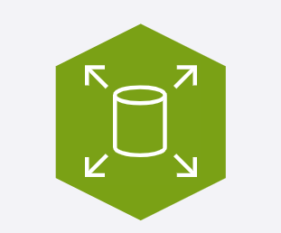
Amazon Elastic Block Store (EBS)
Amazon EBS provides persistent block-level storage volumes for use with Amazon EC2 instances. EBS volumes act like external hard drives, offering consistent and low-latency performance for workloads like databases and file systems.
EBS volumes can be conveniently backed up, resized, and attached to different EC2 instances. To create an EBS volume, you define the configuration for things like volume size and type. After the volume has been created, it can be attached to an Amazon EC2 instance. Because EBS volumes are for data that needs to persist, it’s important to back up the data. It's recommended that you take incremental backups of EBS volumes by creating Amazon EBS snapshots.
Key takeaway: data persistence
Amazon EBS provides block-level storage volumes that you can use with Amazon EC2 instances. If you stop or terminate an Amazon EC2 instance, all the data on the attached EBS volume remains available.
To learn how Amazon EBS manages data when an EC2 instance is stopped, choose each of the following three numbered markers.
Use cases
Some practical use cases of Amazon EBS include database hosting, backup storage for applications, and rapid deployment of development environments using volume snapshots.

Slide 69
Benefits
EBS volumes support data portability through their ability to detach and reattach to instances as needed. There are many practical reasons you might choose to do this.
Data migration
EBS volumes can be easily migrated between Availability Zones using snapshots. The snapshots provide a simple way to move data across regions or create copies.
Instance type changes
Since EBS volumes remain independent of EC2 instances, it's not complicated to attach them to different instance types. This flexibility lets you upgrade or downgrade instances without losing data.
Disaster recovery
EBS snapshots provide reliable backup solutions that can be restored in different regions during emergencies. Regular automated snapshots ensure your data remains protected and quickly recoverable.
Cost optimization
EBS volumes can be modified to different types and sizes to match actual usage patterns. You can switch between storage types or adjust capacity without downtime.
Performance tuning
Amazon EBS offers various volume types to match different workload requirements and IOPS needs. You can adjust volume performance characteristics on the fly to meet changing application demands.

Slide 70
EBS Snapshots
Amazon EBS data lifecycle management involves creating, backing up, and deleting volumes and snapshots. This process optimizes storage costs and helps to ensure data protection.
EBS snapshots are point-in-time backups of EBS volume. They can be used for disaster recovery, data migration, volume resizing, and for creating consistent backups of production workloads. EBS snapshots are incremental, so they only save the blocks on the volume that have changed after your most recent snapshot.
EBS snapshots can be used to create multiple new volumes, and new volumes created from a snapshot are an exact copy of the original volume at the time the snapshot was taken. Snapshots of EBS volumes are stored redundantly in multiple Availability Zones using Amazon S3.
Working with EBS snapshots
In keeping with the AWS shared responsibility model, as the customer, you are responsible for scheduling and managing regular EBS snapshots as part of your backup strategy. This includes monitoring snapshot costs and deleting unnecessary snapshots to avoid excessive charges. You also need to make sure sensitive data within snapshots is encrypted, verify snapshot integrity, and test restoration procedures regularly.
The following illustration shows how EBS snapshots are created from an EBS volume over time. To learn more about how EBS snapshots interact with EBS volumes, choose each of the following three markers.
Benefits
Data protection and recovery
Snapshots enable fast data recovery from corruption, accidental deletion, or system failures using point-in-time backups.
Operational flexibility
Snapshots enable operations like cross-Region data migration, volume resizing, volume cloning, and sharing data across AWS accounts.
Cost effective
Snapshots use incremental backup technology, storing only changed blocks after the initial backup, reducing storage costs and backup time.

Slide 71
Amazon Data Lifecycle Manager
You can automate the creation, retention, and deletion of EBS snapshots using Amazon Data Lifecycle Manager. Amazon Data Lifecycle Manager can schedule snapshots during off-peak hours to minimize performance impact and automatically delete outdated backups to control storage costs. It's particularly valuable for large-scale deployments where manual snapshot management would be time-consuming and error-prone.
How you can use Data Lifecycle Manager to create custom EBS Snapshots policies:
Step 1 : Create an EBS snapshots policy
Create an EBS snapshots policy using the Amazon EC2 console, API calls, AWS Command Line Interface (AWS CLI), SDKs, or AWS CloudFormation.
Step 2: Select target resource type
Choose either an EBS volume or an EC2 instance as the target for the snapshot.
Step 3: Exclude volumes
Narrow down the data to be included in the snapshot by choosing options to exclude either the root volume or data volumes.
Step 4: Set custom schedules
Automate the creation, retention, and deletion of EBS snapshots by setting up custom schedules.
Step 5: Apply additional actions
Before finalizing the policy, you can apply additional actions. These include configuring elements of the snapshots like tags, snapshot archiving, Amazon EBS fast snapshot restore, cross-Region copying, and cross-account sharing.

Slide 72
Amazon Simple Storage Service (S3)
Amazon S3 is a fully managed, highly-available object storage service for storing and retrieving any amount of data as objects. It offers 99.999999999 percent durability, meaning your data is highly protected against loss, and offers features like versioning, lifecycle management, and various storage classes to optimize costs.
Amazon S3 stores files as objects in containers known as buckets, and each object can range in size from a few bytes to several terabytes. It integrates seamlessly with other AWS services and supports a wide range of use cases, from basic backups to complex data lakes.
Elements
S3 objects
An object in Amazon S3 is the fundamental unit of data storage. When you upload a file to Amazon S3, it becomes an object and is stored durably across multiple facilities within your chosen Region.
Each object typically includes the data itself, metadata, and a unique identifier, or key. Objects can be of any file type, such as images, videos, documents, or application data, and can range in size from a few bytes to several terabytes.
Each Amazon S3 object is uniquely identified within a bucket by its key, which is essentially its file name. Objects also have properties like version ID, access control information, and user-defined metadata.
S3 buckets
An S3 bucket is a container for storing objects in Amazon S3. Buckets have a globally unique name across all of AWS, which helps to identify and organize your stored data.
Buckets serve as the basic unit for access control and can hold a virtually unlimited number of objects. They play a crucial role in data management by making it possible to group related objects and apply policies at the bucket level.
When creating a bucket, you specify its name and the Region where it will reside. Buckets can be configured with various settings, including versioning, logging, and access permissions.

Slide 73
Benefits
Virtually unlimited storage
Amazon S3 has no fixed storage limit, scaling automatically to accommodate any amount of data you need to store. Since you only pay for the storage you use, it's a cost-effective solution for growing data needs.
Object lifecycle management
Amazon S3 lifecycle policies automatically move objects between storage classes based on your defined rules, optimizing costs over time. You can set up automatic transitions and expirations to manage data throughout its entire lifecycle.
Broad range of use cases
Amazon S3 supports a wide range of use cases for both cloud-based applications and traditional on-premises workloads. Amazon S3 is commonly used for content distribution, hosting static websites, and delivering media files. It's also a popular choice for things like application data storage, archiving, data lakes, and compliance-driven data retention.
Security and privacy management
Everything you store in Amazon S3 is private by default. You must explicitly grant permissions to access these resources. If you want your Amazon S3 data to be available to everyone on the internet, you can choose to make your buckets and objects public. To more granularly define who can do what with your Amazon S3 resources, Amazon S3 provides several security management features.

Slide 74
More about Amazon S3 security management features
Bucket policies
Amazon S3 bucket policies are resource-based policies that can only be attached to S3 buckets. An S3 bucket policy specifies which actions are allowed or denied on the bucket, in addition to every object in that bucket.
Identity-based policies
Permissions that control what actions users, groups, or roles can perform on S3 resources are configured using identity-based policies. These policies attach directly to identities rather than to the S3 resources themselves. You can use these policies to specify which S3 buckets and objects users can access and what actions they can perform.
Encryption
Amazon S3 provides encryption capabilities to protect data both at rest and in transit. These encryption features help maintain data confidentiality and comply with various security standards and regulations. These capabilities are as follows:
Encryption at rest secures data stored in S3 buckets, preventing unauthorized access to stored objects.
Encryption in transit safeguards data traveling to and from Amazon S3, maintaining secure communication between clients and the service.

Slide 75
Amazon S3 storage classes and use cases
Amazon S3 offers various storage classes to suit a variety of workloads with specific performance, access, resiliency, and cost requirements. They're also designed to address data residency requirements, unpredictable access patterns, archival storage needs, and offer the most cost-effective options for different access patterns.
S3 Standard
S3 Standard is considered general-purpose storage for cloud applications, dynamic websites, content distribution, mobile and gaming applications, and big data analytics. When you upload an object to Amazon S3 without specifying a storage class, the object is added to S3 Standard by default.
S3 Intelligent-Tiering
This tier is useful if your data has unknown or changing access patterns. S3 Intelligent-Tiering stores objects in three tiers: a frequent access tier, an infrequent access tier, and an archive instant access tier. Amazon S3 monitors access patterns of your data and automatically moves your data to the most cost-effective storage tier based on frequency of access.
S3 Standard Infrequent Access (Standard-IA)
S3 Standard-Infrequent Access (S3 Standard-IA) is for data that is accessed less frequently but requires rapid access when needed. S3 Standard-IA offers the high durability, high throughput, and low latency of S3 Standard, with a low per-GiB storage price and per-GiB retrieval fee. This storage tier is ideal if you want to store long-term backups, disaster recovery files, and so on.

Slide 76
S3 One Zone Infrequent Access (One Zone-IA)
S3 One Zone-Infrequent Access (S3 One Zone-IA) stores data in a single Availability Zone, reducing costs compared to S3 Standard-IA, which uses three zones. This storage class suits customers seeking affordable storage for infrequently accessed data without high availability needs. It's perfect for storing secondary backups or easily recreatable data.
S3 Express One Zone
S3 Express One Zone stores data in a single Availability Zone. It was purpose-built to deliver consistent single-digit millisecond data access for your most frequently accessed data and latency-sensitive applications. S3 Express One Zone delivers data access speed up to 10x faster and request costs up to 80% lower than S3 Standard.
S3 Glacier Instant Retrieval
Use S3 Glacier Instant Retrieval for archiving data that is rarely accessed and requires millisecond retrieval. Data stored in this storage class offers a cost savings of up to 68 percent compared to the S3 Standard-IA storage class, with the same latency and throughput performance.

Slide 77
S3 Glacier Flexible Retrieval
S3 Glacier Flexible Retrieval offers low-cost storage for archived data that is accessed 1–2 times per year. With S3 Glacier Flexible Retrieval, your data can be accessed in as little as 1–5 minutes using an expedited retrieval. You can also request bulk retrievals in up to 5–12 hours at no additional cost. It's an ideal solution for backup, disaster recovery, offsite data storage needs, and for when some data occasionally must be retrieved in minutes.
S3 Glacier Deep Archive
S3 Glacier Deep Archive is the lowest-cost Amazon S3 storage class. It supports long-term retention and digital preservation for data that might be accessed once or twice per year. Data stored in the S3 Glacier Deep Archive storage class has a default retrieval time of 12 hours. It is designed for customers that retain data sets for 7–10 years or longer, to meet regulatory compliance requirements. Examples include those in highly regulated industries, such as financial services, healthcare, and public sectors.
S3 Outposts
Amazon S3 Outposts delivers object storage to your on-premises AWS Outposts environment using Amazon S3 APIs and features, and serves workloads with local data residency requirements. It also helps maintain optimal performance when data must remain in close proximity to on-premises applications.

Slide 78
Amazon Elastic File System (EFS)
Amazon EFS is a fully managed, scalable file storage service for use with AWS cloud services and on-premises resources. It operates using the Linux Network File System (NFS) protocol, and automatically scales to petabytes as you add or remove files without disrupting applications. EFS is designed to support a wide variety of workloads and can be accessed by multiple EC2 instances simultaneously.
Amazon EFS benefits
Multi-AZ redundancy
Amazon EFS automatically replicates data across multiple Availability Zones in a region for high availability. This built-in redundancy protects against AZ failures and provides continuous access to your file systems.
Shared access
Amazon EFS supports thousands of concurrent NFS connections, so multiple EC2 instances can access the same file system simultaneously. This shared access model makes EFS ideal for collaborative workloads and distributed applications.
Elastic storage
Amazon EFS automatically grows and shrinks as you add and remove files, with no need to provision or manage storage capacity. And since you only pay for the storage you use, it's cost-effective for varying workload demands

Slide 79
Amazon EFS storage classes
With Amazon EFS, you can create and configure file systems quickly without any minimum fee or setup cost. You pay only for the storage used and you can choose from a range of storage classes designed to fit your use case.
Standard storage classes
The EFS Standard and EFS Standard-Infrequent Access (Standard-IA) storage classes offer Multi-AZ resilience and the highest levels of durability and availability. They have a higher cost associated with them due to higher availability and durability.
One Zone storage classes
The EFS One Zone and EFS One Zone-Infrequent Access (EFS One Zone-IA) provide additional savings by saving your data in a single Availability Zone. By using just one Availability Zone, you can reduce your storage costs when compared to the Standard EFS storage classes.
Archive storage class
The EFS Archive storage class is cost-optimized for data that is accessed only a few times a year or less and that does not need the sub-millisecond latencies of EFS Standard. EFS Archive offers a storage price up to 50% lower compared to EFS Infrequent Access, providing a more cost-optimized experience for cold, rarely-accessed data.

Slide 80
Amazon EFS data lifecycle
You can further optimize Amazon EFS storage costs by automatically moving data between storage classes based on usage patterns. You can create lifecycle policies that determine when and how files transition between different storage tiers. These automated policies help ensure your data resides in the most cost-effective storage class without manual intervention.
Transition to IA
This policy instructs lifecycle management when to move files into the Infrequent Access storage, which is cost-optimized for data that is accessed only a few times each quarter. By default, files that are not accessed in Standard storage for 30 days are transitioned into IA.
Transition to Archive
This policy instructs lifecycle management when to move files into the Archive storage class, which is cost-optimized for data that is accessed only a few times each year or less. By default, files that are not accessed in Standard storage for 90 days are transitioned into Archive.
Transition to Standard
This policy instructs lifecycle management whether to transition files out of IA or Archive and back into Standard storage when the files are accessed in the IA or Archive storage. By default, files are not moved back to Standard storage, and they remain in the IA or Archive storage class when they are accessed.

Slide 81
Amazon FSx
Amazon FSx makes it convenient and cost effective to launch, run, and scale feature-rich, high-performance file systems in the cloud. It supports a wide range of workloads with its reliability, security, scalability, and broad set of capabilities. Compared to Amazon EFS, which focuses on the Network File System (NFS) compatibility, Amazon FSx supports multiple filesystem protocols, including Windows File Server, Lustre, OpenZFS, and NetAPP ONTAP.
Amazon FSx is built on the latest AWS compute, networking, and disk technologies to provide high performance and lower total cost of ownership (TCO). As a fully managed service, it handles hardware provisioning, patching, and backups.
Amazon FSx benefits
File system integration
Amazon FSx supports industry-standard file system protocols, allowing convenient integration with your existing applications, workflows, and development tools.
Managed infrastructure
Amazon FSx reduces the complexity of managing infrastructure while delivering the features and capabilities of traditional file systems.
Scalable storage
Amazon FSx adjusts resources dynamically, eliminating the need for complex capacity planning and manual infrastructure management.
Cost effective
Amazon FSx has a pricing model and automated tiering options that optimize costs by charging only for used storage and moving infrequently accessed data to lower-cost tiers.

Slide 82
Amazon FSx file systems
Amazon FSx file systems
Amazon FSx for Windows File Server
Amazon FSx for Windows File Server provides fully managed shared storage built on Windows Server. It delivers a wide range of data access, data management, and administrative capabilities.
Use cases include the following:
Migrate Windows file servers to AWS.
Accelerate hybrid workloads.
Reduce SQL Server deployment cost.
Streamline virtual desktops and streaming.
Amazon FSx for NetApp ONTAP
Amazon FSx for NetApp ONTAP provides fully managed shared storage in the AWS Cloud with the popular data access and management capabilities of ONTAP.
Use cases include the following:
Migrate workloads to AWS seamlessly.
Build modern applications.
Modernize your data management.
Streamline business continuity.

Slide 83
Amazon FSx for OpenZFS
Amazon FSx for OpenZFS provides fully managed shared file storage built on the OpenZFS file system and accessible through the NFS protocol (v3, v4, v4.1, and v4.2).
Use cases include the following:
Migrate workloads to AWS seamlessly.
Deliver insights faster for data analytics workloads.
Accelerate content management.
Increase dev/test velocity.
Amazon FSx for Lustre
Amazon FSx for Lustre provides fully managed shared storage with the scalability and performance of the popular Lustre file system.
Use cases include the following:
Accelerate machine learning (ML).
Enable high performance computing (HPC).
Unlock big data analytics.
Increase media workload agility.

Slide 84
AWS Storage Gateway
Storage Gateway is a hybrid cloud storage service that makes it possible to seamlessly integrate on-premises environments with AWS Cloud storage. You can use it to extend your local storage to the cloud while maintaining low-latency access to frequently used data.
You can use Storage Gateway to streamline storage management and reduce costs for practical hybrid cloud storage use cases. These include moving backups to the cloud, using on-premises file shares backed by cloud storage, and providing low-latency access to data in AWS for on-premises applications.
Benefits
Seamless integration
Storage Gateway enables smooth connectivity between on-premises applications and AWS Cloud storage, preserving existing workflows and minimizing disruption.
Improved data management
Storage Gateway provides centralized management of hybrid storage environments, enhancing accessibility, security, and compliance.
Local caching
Storage Gateway locally keeps frequently accessed data for quick access while managing less-used data in the cloud.
Cost optimization
Storage Gateway reduces on-premises storage costs by using cloud storage for data archiving, backup, and disaster recovery purposes.

Slide 85
Gateway types
Storage Gateway offers three distinct types of gateways to meet different hybrid storage needs. Each gateway type is designed to address specific use cases and workload requirements.
Amazon S3 File Gateway
Amazon S3 File Gateway bridges your local environment with Amazon S3. It provides on-premises applications with access to virtually unlimited cloud storage through familiar file protocols. S3 File Gateway makes it possible to store and retrieve cloud objects using familiar file operations.
When you deploy an S3 File Gateway, it appears to your local systems as a standard file server. Files written to this server are automatically uploaded to Amazon S3 while maintaining local access to recently used data through intelligent caching. This means your applications can continue working with files as they always have while the actual data is securely stored in the AWS Cloud.
Volume Gateway
With Volume Gateway, you create virtual storage volumes while maintaining local access to your data. It essentially functions as a bridge between your on-premises infrastructure and AWS Cloud storage by presenting your cloud data as iSCSI volumes that can be mounted by your existing applications.
Volume Gateway operates in two main configurations:
Cached volume mode stores primary data in the cloud while frequently accessed data is cached locally for low-latency access.
Stored volume mode locally keeps your complete dataset while asynchronously backing it up to the cloud as EBS snapshots.
Tape Gateway
Tape Gateway makes it possible to replace physical tape infrastructure with virtual tape capabilities while benefitting from the durability and scalability of AWS Cloud storage. Tape Gateway provides an interface that works with existing tape backup software, making the transition from physical tapes to cloud storage seamless.
When you deploy a Tape Gateway, it presents itself to your backup applications as standard tape hardware. Your backup software writes data to these virtual tapes just as it would to physical tapes and stored in Amazon S3. You can also configure Tape Gateway to automatically transition less frequently accessed data to a more cost-effective storage class for long-term retention.

Slide 86
Elastic Disaster Recovery
Elastic Disaster Recovery replicates critical workloads to AWS with minimal downtime. Your servers' block-level data is continuously replicated to AWS, making it ideal for uses that require robust disaster recovery solutions. It supports both physical and virtual servers to enable rapid recovery during disruptions, which is particularly valuable for industries like healthcare where system availability is crucial.
You can use Elastic Disaster Recovery to reduce downtimes and data loss while eliminating the costs associated with maintaining secondary data centers. It also offers non-disruptive disaster recovery testing, meaning it's capable of quickly launching recovery instances when needed.
Business resilience
Maintain business operations with continuous block-level data replication and the ability to recover workloads within minutes during disruptions.
Streamlined disaster recovery
Automate disaster recovery processes through an intuitive console, reducing complex manual configurations and minimizing the risk of human error.
Cost optimization
Eliminate expensive secondary data centers and pay only for what you use, with minimal upfront investment and no standby infrastructure costs.
Use cases
Healthcare data protection
Financial services continuity
Manufacturing operations recovery

Slide 87
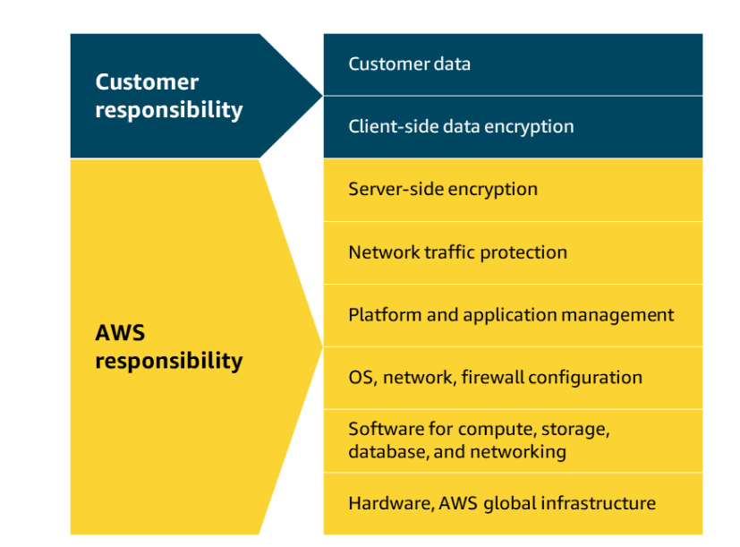
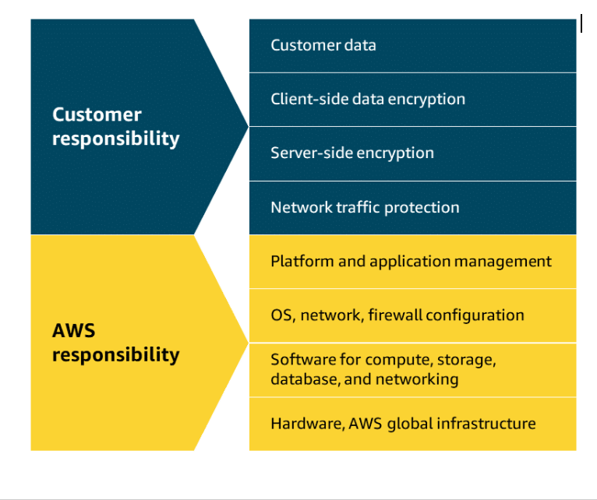
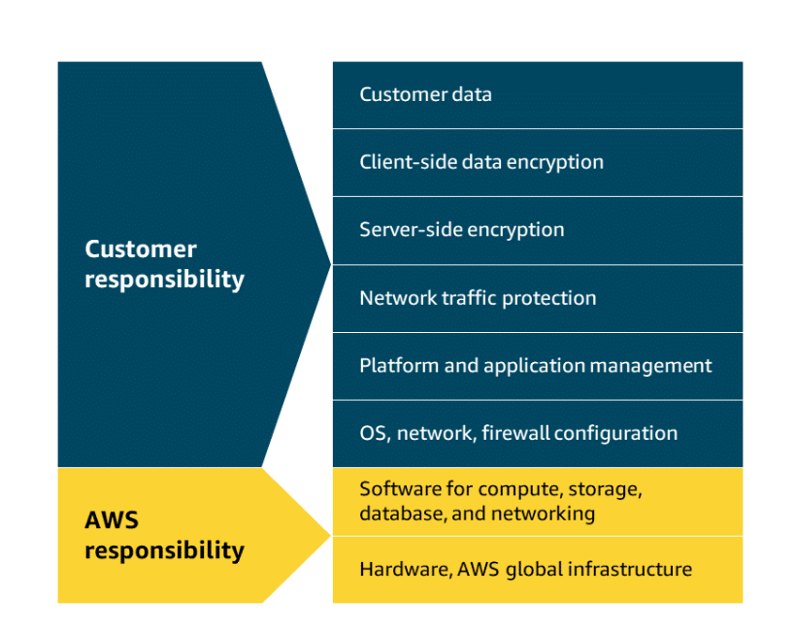
Module 7: Databases
AWS shared responsibility model
The AWS shared responsibility model groups services into three categories based on the ownership of administrative tasks. These categories are fully managed, managed, and unmanaged. The AWS services that you will be exploring in this module are primarily fully managed, with a few managed services, and no unmanaged services.
Fully managed services
For fully managed services, AWS handles nearly all operational tasks like provisioning, scaling, patching, backups, performance optimization, and security patches. AWS also provides built-in monitoring and metrics. Fully managed AWS database services only require customers to be responsible for designing data structures and managing access controls.
Managed services
With managed database services, AWS handles routine tasks like backups, patching, and hardware provisioning while customers are responsible for database configuration, query optimization, and performance tuning decisions.
Unmanaged services
With unmanaged databases, customers are responsible for installation, configuration, patching, maintenance tasks, database security, backups, high availability setup, and performance optimization. An example of an unmanaged database in AWS would be a database management system like MySQL installed directly on an Amazon Elastic Compute Cloud (Amazon EC2) instance.

Slide 88
Relational databases
Relational databases store data in a way that relates it to other pieces of data, and they use structured query language, or SQL, to manage and query data. This approach stores data in an easily understandable, consistent, and scalable way that works great for applications requiring structured data management.
AWS offers fully managed relational database solutions that remove the burden of database administration while maintaining high availability and security. AWS relational databases support popular database engines like MySQL, PostgreSQL, and Oracle, making it easier to migrate existing databases to AWS.
An example of a relational database would be an inventory management system for a restaurant. Each record in the database includes data for a single item, such as product name, size, price, and so on. The following table shows how this type of data is configured in a relational database.

Slide 89
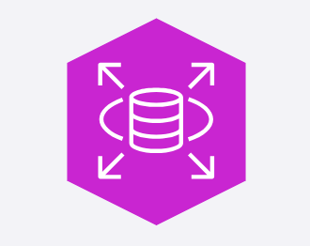
Amazon Relational Database Service (Amazon RDS)
Amazon RDS is a managed relational database service that handles routine database tasks such as backups, patching, and hardware provisioning. Amazon RDS supports multiple database instance class types that optimize for memory, performance, or input/output (I/O).
To improve data resilience, Amazon RDS offers Multi-AZ deployment and automated backups, but you can also manually create backups using DB snapshots. These are full backups of your entire database instance, which can be useful for specific point-in-time recovery or long-term data archiving purposes. Amazon RDS offers security features including network isolation, encryption in transit, and encryption at rest. You can readily scale database resources vertically or horizontally as needed.
Supported database engines
Amazon RDS supports different database engines, including Amazon Aurora, MySQL, PostgreSQL, Microsoft SQL Server, MariaDB, and Oracle Database.
Use cases
Some examples of practical use cases for Amazon RDS are web applications, enterprise workloads, and product inventories for e-commerce platforms.
Benefits
Cost optimization
Multi-AZ deployment
Performance optimization
Security controls

Slide 90
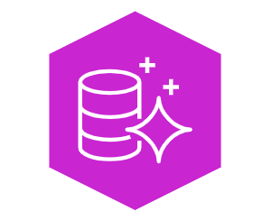
Amazon Aurora
Aurora is a managed relational database designed to help reduce unnecessary I/O operations. It's compatible with MySQL and PostgreSQL, provides high performance and availability, and automatically scales alongside your workloads. Aurora replicates data across multiple Availability Zones for enhanced durability and fault tolerance, and features automated backups, encryption at rest, and continuous monitoring.
Use cases
Some examples of practical use cases for Aurora are gaming applications, media and content management, and real-time analytics.
Benefits
High performance and availability
Aurora delivers up to five times the throughput of standard MySQL and three times the throughput of PostgreSQL. It uses a distributed storage system across multiple nodes to provide high performance and availability.
Automated storage and backup management
Aurora automatically grows storage from 10 GB to 128 TB based on your actual data usage, which eliminates guesswork in capacity planning. It also continuously backs up your database to Amazon Simple Storage Service (Amazon S3) to provide point-in-time recovery.
Advanced replication and fault tolerance
Aurora replicates data across three Availability Zones with six copies of data, and provides 99.99% availability. It automatically detects database failures and redirects traffic to healthy replicas without data loss.

Slide 91
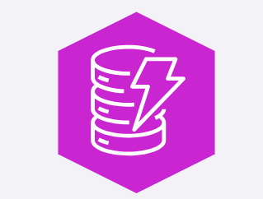
Amazon DynamoDB
NoSQL databases
NoSQL databases are sometimes referred to as non-relational databases because their structures are different than relational databases like Amazon RDS. Instead of row and column relationships, NoSQL databases build a structure for the data that they contain using key-value pairs instead. With key-value pairs, data is organized into items identified by unique keys.
Each key has one or more associated attributes, or values, that represent various characteristics of the data. You can think of a key as a word entry in a dictionary, and the value as its associated definition. Not every item in the table has to have the same attributes, and you can add or remove attributes at any time.
DynamoDB is a fully managed NoSQL database service that provides fast and predictable performance for both document and key-value data structures. It's a powerful and incredibly fast database option for use cases that require a flexible schema, and is ideal for applications that require high performance and seamless scaling.
DynamoDB seamlessly scales alongside your data without impacting performance, which means that you only pay for the resources that you use. It also includes built-in security features for enhanced protection, and automatically spreads your data across multiple servers to handle your workload.
Use cases
Some examples of practical use cases for DynamoDB are gaming platforms, financial service applications, and mobile applications with global user bases.

Slide 92
Benifits
Scalability with provisioned capacity
DynamoDB automatically scales throughput up or down based on actual usage, which ensures consistent performance without manual intervention. You can specify target utilization levels, and DynamoDB automatically provisions capacity to maintain those targets. With no practical limits on table size or the amount of data stored, DynamoDB can seamlessly accommodate growing applications
Consistent high performance
DynamoDB delivers single-digit millisecond response times at any scale, which makes it ideal for high-performance applications. It maintains consistent performance by automatically distributing data across multiple servers and SSDs.
High availability and durability
DynamoDB delivers 99.999% data availability by replicating data across three distinct facilities within each AWS Region. It also maintains multiple copies in separate AWS Regions, to provide built-in fault tolerance and data durability. This ensures continuous operation and protection against data loss even if individual facilities fail.
Data encryption
DynamoDB offers comprehensive encryption capabilities to protect information both at rest and in transit. All data is automatically encrypted behind the scenes before being written to the storage layer. DynamoDB includes the flexibility to choose between different kinds of encryption keys for customized security control.

Slide 93
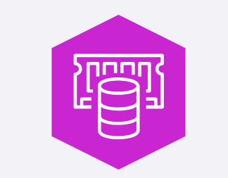
In-memory caches
An in-memory cache is a high-speed storage layer that temporarily stores frequently accessed data in a computer's main memory, or RAM. Retrieving data from RAM provides extremely fast processing and retrieval speeds, often hundreds or thousands of times faster than traditional disk-based storage systems.
When applications need specific information, they first check the cache before requesting it from the original data source. This reduces the load on primary databases and speeds up response times for end users. In-memory caches are ideal for storing session data, API responses, database query results, and other information that applications require repeatedly.
Amazon ElastiCache
ElastiCache is a fully managed in-memory caching service that was built to help reduce the complexity of administering in-memory caching systems. This means that you can continue to use the same Redis, Valkey, or Memcached tools and configurations to scale your workloads. It automatically detects and replaces failed nodes, which makes it ideal for applications that need consistent high performance.
Use cases
Some examples of practical use cases for ElastiCache are session data management, database query enhancement, and gaming leaderboards.

Slide 94
Benefits
High performance for Redis, Valkey, or Memcached instances
ElastiCache streamlines the deployment and maintenance of in-memory caching environments, offering high availability for Redis, Valkey, and Memcached by automatically handling hardware provisioning, software patching, and monitoring. ElastiCache offers seamless scalability so you can add or remove nodes as demand changes.
High availability
ElastiCache provides high availability by constantly monitoring primary nodes for potential failures. When issues are detected, it maintains application availability while promoting a replica node to become the new primary without manual intervention. The entire recovery process typically finishes within minutes, which minimizes downtime and preserves operations during infrastructure disruptions.
Replication across multiple Availability Zones
ElastiCache enables automatic replication across multiple Availability Zones to protect against infrastructure failures. You can configure primary and replica nodes across different Availability Zones according to their durability requirements. This helps to ensure that data remains accessible even if one zone experiences an outage.
Data encryption
ElastiCache supports data encryption mechanisms to safeguard sensitive information throughout its lifecycle. At-rest encryption protects data while stored in disk storage and automated backups. In-transit encryption secures data traveling between clients and cache nodes by employing transport layer security, or TLS, for encrypted connections.

Slide 95
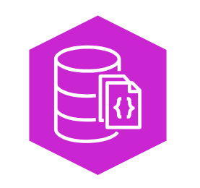
Amazon DocumentDB
Amazon DocumentDB (with MongoDB compatibility) is fully managed service designed to handle semistructured data, which is information that doesn't conform to rigid relational schemas. Amazon DocumentDB is a MongoDB-compatible database, so it manages JSON-like documents with dynamic schemas.
Amazon DocumentDB is perfect for applications requiring frequent schema changes and document-oriented data. Unlike relational databases or nonrelational databases, you can quickly iterate without relying on predefined schemas. Amazon DocumentDB can store, query, and index JSON data effortlessly, all while benefiting from automatic scaling, continuous backup, and enterprise-grade security features.
Use cases
Some examples of practical use cases for Amazon DocumentDB are content management systems, catalog and inventory management, and user profile and personalization systems.
Benefits
MongoDB compatibility
Amazon DocumentDB is fully compatible with MongoDB workloads and supports MongoDB APIs, drivers, and tools. This compatibility means that you can use existing MongoDB code and skills without modification. You can also migrate MongoDB applications to Amazon DocumentDB with minimal changes to their application code.
Performance and scalability
Amazon DocumentDB automatically scales storage up to 64 TB in 10 GB increments based on your application needs. It can handle millions of requests per second with consistent performance. It also provides the option to scale compute resources up or down as needed.
Increased read throughput
Amazon DocumentDB improves read throughput for high-volume applications by creating up to 15 replica instances that share underlying storage.

Slide 96
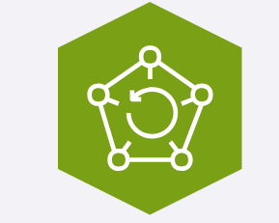
AWS Backup
AWS Backup streamlines data protection across various AWS resources and on-premises deployments by providing a single dashboard for monitoring and managing backups. It eliminates the complexity of managing multiple backup strategies by supporting multiple storage types, including Amazon Elastic Block Store (Amazon EBS) volumes, Amazon Elastic File System (Amazon EFS) file systems, and various databases.
AWS Backup centralizes and automates data protection processes, improving consistency and reducing administrative overhead. It offers flexible scheduling options, encryption capabilities, and cross-Region backup support for enhanced disaster recovery.
Use cases
Some examples of practical use cases for AWS Backup are centralized disaster recovery, consistent backup policies for compliance requirements, and consolidating multiple backup processes through a single interface.
Benefits
Centralized backup management
AWS Backup provides a single dashboard to manage backups across multiple AWS services and accounts. You can monitor backup jobs, restore points, and verify compliance status from one central location to reduce operational complexity and potential configuration errors.
You can create automated backup schedules that align with your business requirements and compliance needs. You can set up backup policies that automatically protect new resources as they're created.
Cross-region backup redundancy
AWS Backup enables automatic replication of backup data across different AWS Regions for disaster recovery purposes. You can quickly restore data from secondary Regions if the primary Region experiences an outage. Cross-Region redundancy helps you meet compliance requirements while guaranteeing data accessibility during Regional failures.
Streamlined regulatory compliance
AWS Backup maintains detailed audit logs and reports to demonstrate compliance with regulatory requirements. You can use it to enforce backup policies across your organization and track backup activities for security and compliance purposes.

Slide 97
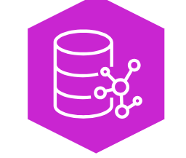
Amazon Neptune
Neptune is a fully managed, purpose-built graph database service that manages highly connected data sets, like those used in social networking applications. It excels at understanding complex relationships that are difficult to identify in traditional relational databases like user connections, friend networks, and interaction patterns. Neptune can maintain high performance even as data complexity grows, and offers high availability with automatic failover and backups.
Use cases
Some examples of practical use cases for Amazon Neptune are social network user connection mapping, fraud detection systems, and search and recommendation systems.
Benefits
Purpose-built for complex relationships
Neptune excels at storing and querying highly connected data using graph models. It supports both property graph and resource description framework, or RDF, models making it ideal for relationship mapping and pattern matching applications.
High performance and scalability
Neptune delivers consistent performance at scale, processing billions of relationships in milliseconds. It automatically grows storage up to 64 TB based on your application needs. Its purpose-built engine optimizes graph queries to enable fast traversal of connected data points at scale.

Slide 98
Module 8: AI ML and Data Analytics
AI Artificial Intelligence is a broad field focused on the development of intelligent computer systems capable of performing humanlike tasks.
ML Machine learning is a type of AI for training machines to perform complex tasks without explicit instructions. Machine learning training finds the patterns hidden in vast amounts of historical data to produce an ML model. This ML model can then be applied to new data to make predictions or decisions based on the patterns it's learned.
AI/ML helps solve for many common business use cases. At AWS, solutions for these common use cases, and others, are offered through the AWS AI/ML stack.
Common ML business use cases
ML models power the Amazon.com e-commerce recommendations engine. But, ML can solve for lots of other business use cases, such as the following:
Predict trends, such as future stock prices.
Make decisions, like routing callers to the right department.
Detect anomalies, such as bank fraud.
AWS AI/ML solutions
The AWS AI/ML stack is composed of the following three tiers of solutions:
AI services - pre-built models that are already trained to perform specific functions
ML services - a more customized approach with Amazon SageMaker AI where you build, train, and deploy your own ML models with fully managed infrastructure
ML frameworks and infrastructure - a completely custom approach to building models using purpose-built chips that integrate with popular ML frameworks

Slide 99
AI/ML Solutions
Let's examine the three tiers of the AWS AI/ML stack in more detail. You can think of the tiers as a progression from pre-built, easily deployable managed solutions to highly customized solutions that require more skill to implement.
Tier 1: Pre-built AWS AI services
The AWS AI services tier is made up of pre-built models that are already trained to perform specific functions. These ready-to-use, managed services can help you quickly solve for a variety of business use cases. In the next section, you will learn about the following three groups of AWS AI services:
Language services
Computer vision and search services
Conversational AI and personalization services

Slide 100




Language services
AWS AI language services are great for when you need to interpret text or speech and transform it into something meaningful. Let's examine how these services solve for some common use cases.
Amazon Comprehend
Amazon Comprehend uses natural language processing to extract key insights from documents. It develops these insights by recognizing key phrases, language, sentiment, and other common elements in documents.
Use cases: Content classification, customer sentiment analysis, and compliance monitoring
Amazon Polly
Amazon Polly converts text into lifelike speech. It supports multiple languages, different genders, and a variety of accents.
Use cases: Virtual assistants, e-learning applications, and accessibility enhancements for visually impaired users
Amazon Transcribe
Amazon Transcribe converts speech into text. It supports multiple languages and offers features such as speaker identification, custom vocabulary, and real-time transcription.
Use Cases: Customer call transcription, automated subtitling, and metadata generation for media content.
Amazon Translate
Amazon Translate is a text translation service. This service is ideal for global communication because it supports real-time and batch text translation across multiple languages.
Use cases: Document translation and multi-language application integrations

Slide 101
Computer vision and search services
These services are ideal for answering questions and gathering insights from various types of content sources such as documents, images, videos, and more. Let's look at some examples.
Amazon Kendra
Amazon Kendra uses natural language processing to search for answers within large amounts of enterprise content. Because it understands the context of a query, it can return more precise and relevant answers than just a list of documents with matching keywords.
Use cases: Intelligent search, chatbots, and application search integration
Amazon Rekognition
Amazon Rekognition is a video analysis service. It can identify objects, people, text, scenes, and activities within images and videos stored in Amazon Simple Storage Service (Amazon S3).
Use cases: Content moderation, identity verification, media analysis, and home automation experiences
Amazon Textract
Amazon Textract detects and extracts typed and handwritten text found in documents, forms, and even tables within documents.
Use cases: Financial, healthcare, and government form text extraction for quick processing

Slide 102
Conversational AI and personalization services
With these services, users can interact with your apps through text and voice conversations. You can also present your customers with product recommendations personalized just for them. Let's explore these services.
Amazon Lex
With Amazon Lex, you can add voice and text conversational interfaces to your applications. This service uses both natural language understanding (NLU) and automatic speech recognition (ASR) to create lifelike conversations.
Use cases: Virtual assistants, natural language search for FAQs, and automated application bots
Amazon Personalize
With Amazon Personalize, you can use historical data to build intelligent applications with personalized recommendations for your customers.
Use cases: Personalized streaming, product, and trending recommendations

Slide 103
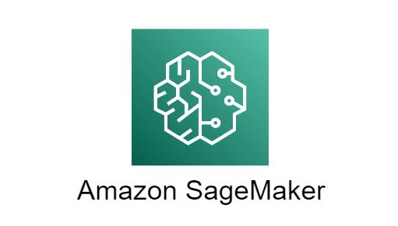
Tier 2: ML services
The ML services tier provides a more customized approach for customers who want a bit more control over their ML solutions without having to manage infrastructure. SageMaker AI is a key offering in this tier.
Amazon SageMaker AI
With this fully managed service, you can build, train, and deploy your own ML models without worrying about infrastructure. The SageMaker AI integrated development environment (IDE) provides simplified access control and transparency over your ML projects. You can track model training experiments, visualize data, and debug and monitor your workflows all within one environment. SageMaker AI even offers access to hundreds of pre-trained models that you can deploy in a few quick steps.
Key benefits of SageMaker AI
Choice of ML tools
Increase innovation with different tool choices. Data scientists can use the IDE, and business analysts can use the no-code interface.
Click to flip
Fully managed infrastructure
Focus on ML model development while SageMaker AI provides you with high-performance, cost-effective infrastructure.
Click to flip
Repeatable ML workflows
Automate and standardize your MLOps practices and governance across your enterprise to support transparency and auditability.

Slide 104
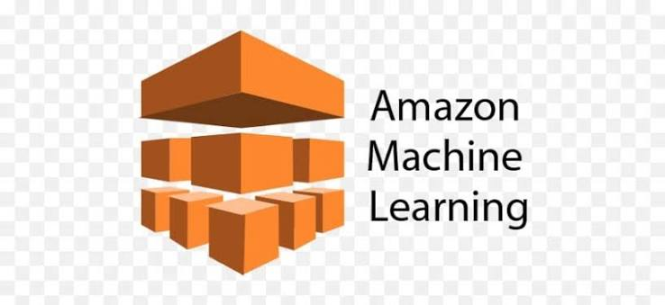
Tier 3: ML frameworks and infrastructure
Some organizations have highly specialized needs that require complete control over the ML training process. They can use in-house expertise, ML frameworks, and AWS infrastructure to develop their own ML solutions.
Core components
ML frameworks
An ML framework is a software library or tool that provides experienced ML practitioners with pre-built, optimized components for building machine learning models. AWS supports ML frameworks like PyTorch, Apache M-X Net, and TensorFlow.
AWS ML infrastructure
AWS ML infrastructure, such as ML-optimized Amazon Elastic Compute Cloud (Amazon EC2) instances, Amazon EMR, and Amazon Elastic Container Service (Amazon ECS), can support these custom solutions. These services provide high performance and flexibility for advanced ML workloads.

Slide 105
Introduction to Generative AI on AWS
Deep learning
Deep learning (DL) is a subset of machine learning where models are trained using layers of artificial neurons that mimic the human brain. Each layer of these neural networks summarizes and feeds information to the next layer until a final model is produced.
Generative AI
Generative AI is a type of deep learning powered by extremely large ML models known as foundation models (FMs). FMs are pre-trained on vast collections of data. While traditional ML models are trained to perform singular tasks, FMs can be adapted to perform multiple tasks.
Large language models (LLMs), are a popular type of FM trained to use human language. Foundation models can also be used to create videos, images, music, and more.
Generative AI on AWS
AWS offers the following types of generative AI solutions:
Amazon SageMaker JumpStart—An ML hub with FMs and pre-built ML solutions deployable with a few clicks
Amazon Bedrock—A fully managed service for adapting and deploying FMs from Amazon and other leading AI companies
Amazon Q—An interactive AI assistant that can be integrated with a company's information repositories

Slide 106

Amazon SageMaker JumpStart
SageMaker JumpStart is a machine learning hub within SageMaker AI that accelerates the process of building, training, and deploying ML models. SageMaker JumpStart offers a library of pre-built ML solutions across various domains such as computer vision, NLP, and tabular data. These pre-trained models can be fine-tuned to suit your specific needs and deployed with just a few clicks.
Common use cases for SageMaker JumpStart
Rapid ML model deployments
Quickly deploy pre-trained models without extensive ML expertise.
Click to flip
Custom fine-tuned solutions
Fine-tune pre-trained FMs with your domain-specific data.
Click to flip
ML experiments and prototypes
Compare performance for different models before committing to a specific approach.

Slide 107

Amazon Bedrock
Amazon Bedrock is a fully managed service that was specifically designed for working with large foundation models and building generative AI applications. It provides access to FMs from Amazon and leading AI startups, such as Claude and Stable Diffusion, all through a single unified API. With Amazon Bedrock, you can quickly experiment with FMs, fine-tune them with your own data, and seamlessly integrate them into your AWS applications.
Common use cases for Amazon Bedrock
Enterprise-grade generative AI
Build production-ready generative AI applications with enterprise-level security, privacy, and scalability.
Click to flip
Multimodal content generation
Create applications that can generate multiple content types, such as text and images.
Click to flip
Advanced conversational AI
Develop advanced conversational agents that connect to your enterprise data to provide accurate responses.

Slide 108
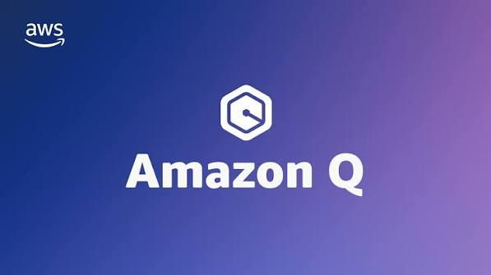
Amazon Q products
Amazon Q is a generative AI assistant that can help companies streamline processes, get to decisions faster, and improve employee productivity. It can help every employee gain insights into their data and accelerate their tasks.
Amazon Q consists of the following two products.
Amazon Q Business
Amazon Q Business can answer pressing questions, help solve problems, and take actions using the data and expertise found in your company's information repositories. Amazon Q Business provides this tailored assistance with a secure connection to commonly used systems.
Use cases: Information requests, automated workflows, and insight extraction
Amazon Q Developer
Amazon Q Developer provides code recommendations to accelerate development for coding languages including C#, Java, JavaScript, Python, and TypeScript applications. It integrates with multiple IDEs and helps developers write code faster by generating entire functions and logical blocks of code.
Use cases: Faster code generation, improved reliability and security, and automated code reviews

Slide 109
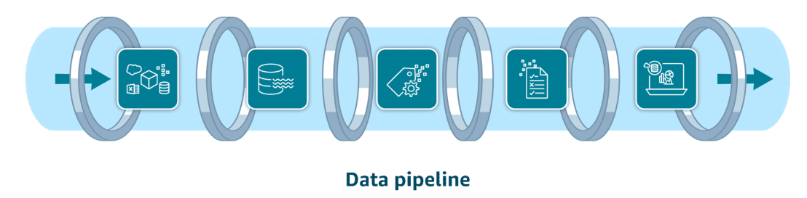
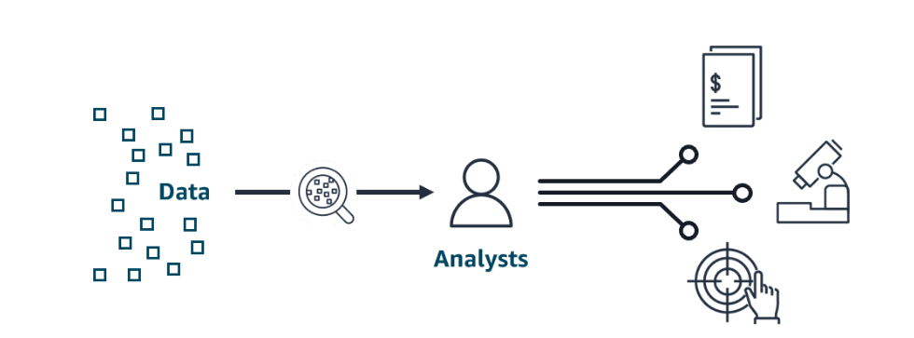
Introduction to Data Analytics
Data pipelines for ETL processes
Both AI/ML and traditional data analytics need clean and accessible data in a format that's usable by analytics tools and AI algorithms. ETL processes are used for this purpose. With ETL, you perform the following steps:
Extract the data from various sources and store it.
Transform it into a consistent, usable format for downstream tools to consume.
Load it into a destination system, like a data warehouse or analytics platform.
Data pipelines are automated assembly lines used to make the ETL process efficient and repeatable. AWS has a suite of integrated services so you can build your own data pipelines.
Data analytics
Data analytics is when analysts transform raw historical data to uncover valuable insights and trends. This traditional data analysis can apply to important use cases, such as the following:
Loan companies explaining lending decisions to customers.
Medical researchers analyzing clinical trial data through hypothesis testing.
Insurance companies making their risk assessment models transparent for regulators.

Slide 110



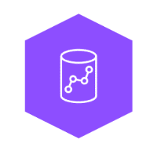
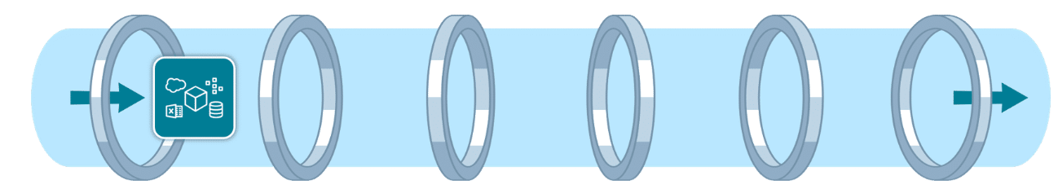
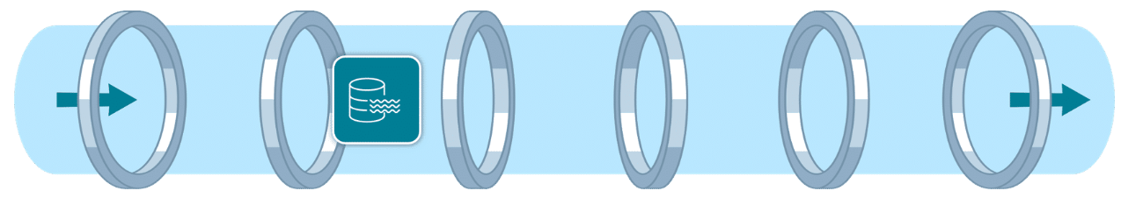
Data Pipelines on AWS
AWS data pipeline services
Data ingestion services
Data ingestion involves moving data from source systems into your chosen storage solution. Use real-time ingestion when the data is needed immediately. Use batch ingestion when some latency is tolerable.
Amazon Kinesis Data Streams
You can use Kinesis Data Streams for real-time ingestion of terabytes of data from applications, streams, and sensors. This serverless service even provides automatic provisioning and scaling in on-demand mode.
Amazon Data Firehose
Firehose is an option for data ingestion in near real-time. This fully managed service provides automatic provisioning and scaling. It also delivers data within seconds to data lakes, warehouses, and analytics services.
Data storage services
Data can come from many different sources. To gain insights, data is commonly consolidated into a single location. There are two storage options for this. Flexible data lakes store vast amounts of raw data. Alternatively, the more structured data warehouses are optimized for business intelligence.
Amazon S3
Amazon S3 is a popular choice for data lakes. This object storage service can securely house virtually any amount of structured or unstructured data. Amazon S3 is also fully elastic, automatically scaling as you add and remove data.
Amazon Redshift
Amazon Redshift is a fully managed data warehouse service that can store petabytes of structured or semistructured data. With the scalability and pay-as-you-go pricing model, organizations can cost-effectively analyze large datasets.

Slide 111
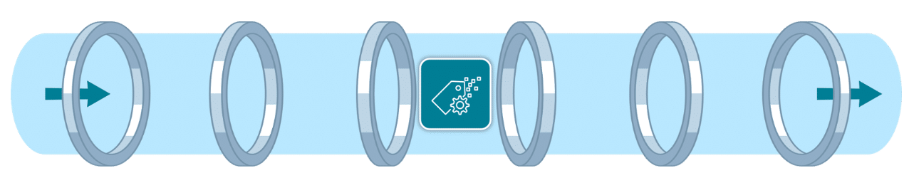
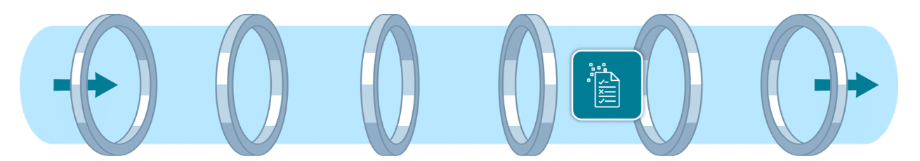



Data cataloging services
Cataloging your data with metadata provides an inventory of your organization's data.
AWS Glue Data Catalog
AWS Glue Data Catalog provides a centralized, scalable, and managed metadata repository that enhances data discovery. It improves the overall efficiency of data pipelines by delivering metadata to various data stores and analytics services.
Data processing services
Data processing services clean and transform your data so it's ready to be analyzed.
AWS Glue
AWS Glue is a fully managed ETL service that makes data preparation simpler, faster, and cost effective. AWS Glue ETL jobs can use the AWS Glue Data Catalog to access metadata about data sources, which can help inform transformations defined in the ETL script.
Amazon EMR
Amazon EMR is ideal for large-scale data processing and organizations with existing big data expertise. It automatically handles infrastructure provisioning, cluster management, and scaling. Amazon EMR supports popular big data frameworks like Apache Spark, Apache Hadoop, and Apache Hive.

Slide 112
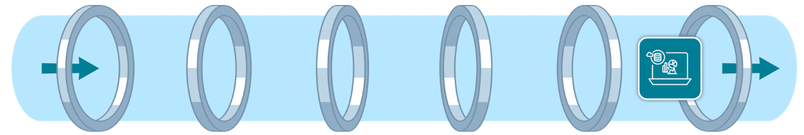

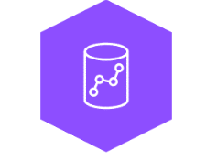


Data analysis and visualization services
Queries and visualization tools help you to develop important insights about your data.
Amazon Athena
With Athena, you can run SQL queries to analyze data in relational, nonrelational, object, and custom data sources. This fully managed serverless service can access data hosted on Amazon S3, on premises, or even in multi-cloud environments. It offers a cost-effective solution for data analysis because you only pay for the queries you run.
Amazon Redshift
Amazon Redshift is a fully managed data warehouse solution. Its columnar storage and massively parallel processing architecture make it ideal for analyzing large datasets. You can use it to perform complex SQL queries on large datasets for frequent, high-performance analytical workloads.
Amazon QuickSight
With QuickSight, both technical and non-technical users can quickly create modern interactive dashboards and reports from various data sources without managing infrastructure. Amazon Q in QuickSight provides natural language queries so business analysts and users can build, discover, and share meaningful insights in seconds.
Amazon OpenSearch Service
With OpenSearch Service, you can search for relevant content through precise keyword matching or natural language queries. Unified dashboards provide real-time data visualization as you analyze and monitor logs, traces, and metrics for various applications.

Slide 113
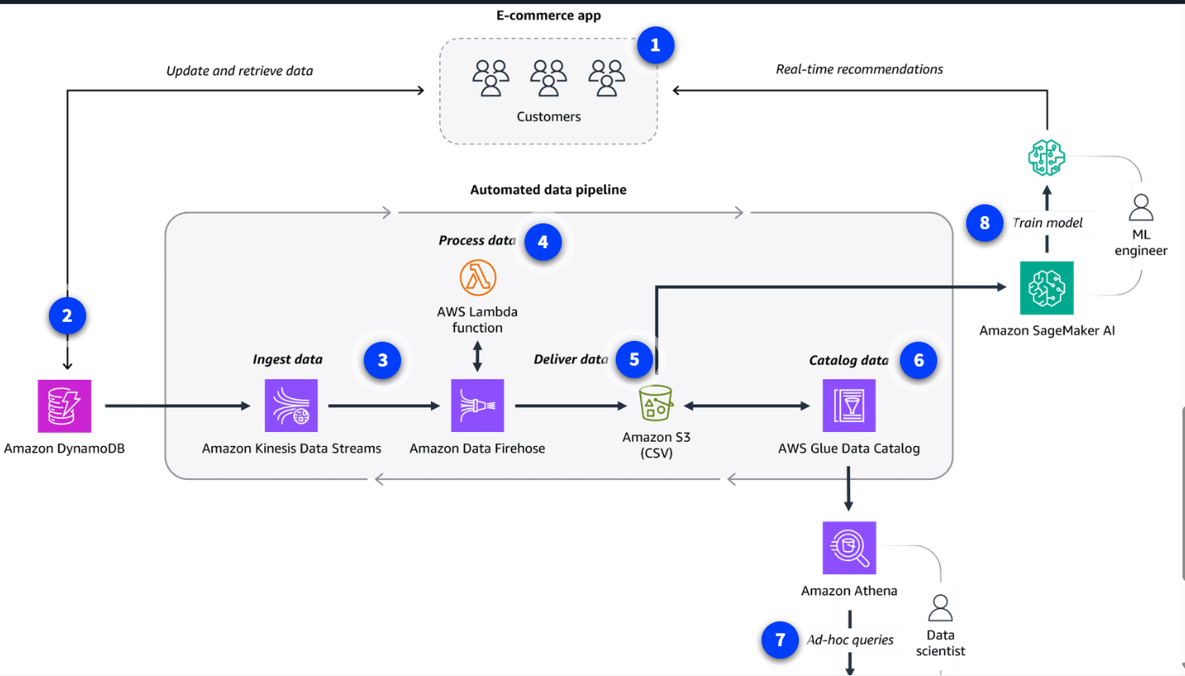
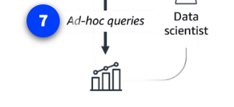
Data Analytics and AI/ML
Data analytics and AI/ML architecture diagram
Delivering customer data for analysis and ML model training

Slide 114
Flow of the diagram:
Make recommendations An e-commerce company uses an ML model to make product recommendations.
Store app data An Amazon DynamoDB database stores the historical customer data gathered through the app. This makes sense for low-latency reads and writes but isn't ideal for ML model training.
Ingest data Kinesis Data Streams ingests the data from DynamoDB. Amazon Data Firehose then aggregates the data.
Process data The data is in JSON format, so Firehose invokes an AWS Lambda function that transforms the data into .csv format.
Deliver data Firehose then delivers the data to the company's Amazon S3 data lake, where it is available for multiple consumers.
Catalog data AWS Glue Data Catalog serves as a metadata repository with tables that describe the schema and location of the Amazon S3 data.
Perform data analytics Data scientists use Athena to gather insights through queries.

Slide 115
Module 9: Security
Authentication and authorization
Authentication is the process of verifying the identity of a user or entity through credentials like a username and password combination.
Use case: An employee logs in to an employee portal.
Authorization grants users certain access rights and permissions that determine which actions they can perform in a system or application.
Use case: An employee can only access their own employee records inside the employee portal.
AWS security controls
AWS offers multiple security mechanisms to protect your cloud resources. These controls can help you do the following:
Prevent security incidents through proper permission and access management.
Protect networks, applications, and data.
Detect and respond to security incidents as they occur.

Slide 116
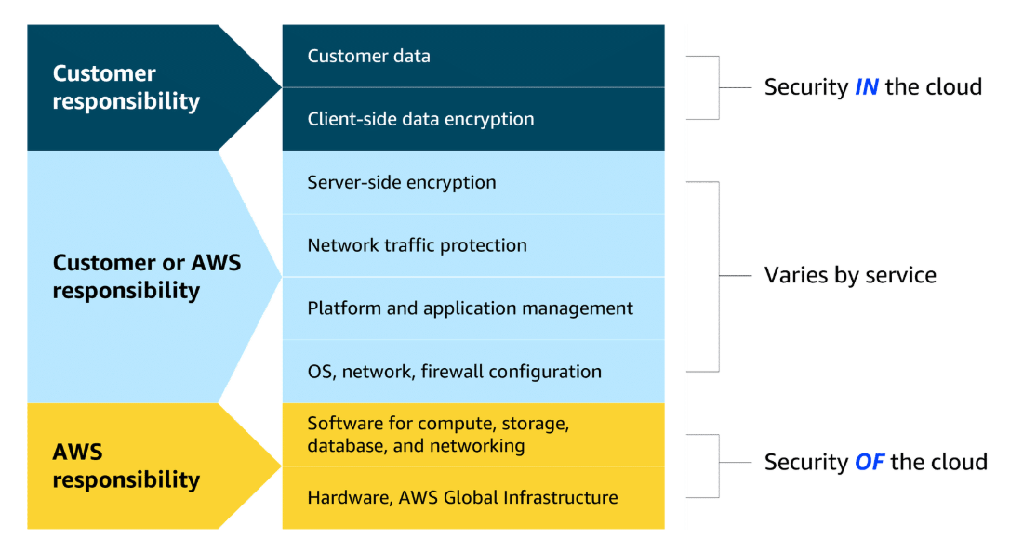
AWS shared responsibility model
Cloud security is a shared responsibility between customers and AWS. Let's examine this relationship using the AWS shared responsibility model.
Customers: Security in the cloud
When using AWS services, customers maintain complete control over their content. As a result, customers are responsible for securing everything they create and manage in the AWS Cloud. This includes the following:
Managing the security of data, systems, and applications
Deciding what data and workloads to store or run in AWS
Determining which AWS services to use
Controlling who has access to environments and resources
AWS: Security of the cloud
AWS is responsible for security of the cloud. AWS operates, manages, and controls the components at all layers of the infrastructure. This includes securing the following:
The foundational software that powers AWS services
The virtualization layer
The hardware and global infrastructure that supports the data centers from which services operate. This includes protection for AWS Regions, Availability Zones, and edge locations.

Slide 117
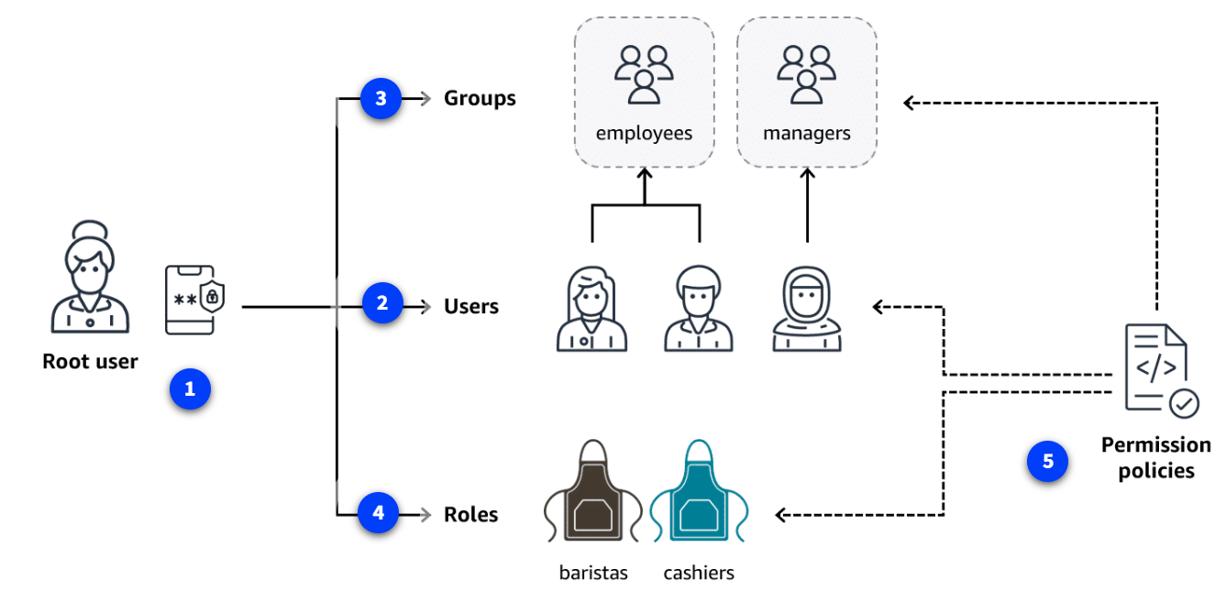
Preventing Unauthorized Access
AWS Identity and Access Management (IAM)
Securely manage identities and access to AWS services and resources.
One of the best ways to prevent security incidents before they happen is through proper permission and access management. With IAM, by default, all actions are denied. You must explicitly grant permission to someone before they can perform any actions in your account.
When you grant permissions, you should provide access only on a need-to-have basis. This concept is called the principle of least privilege.
The principle of least privilege dictates that you should only give people and systems access to what they need and nothing else.
IAM provides users, groups, and roles so you can configure access based on your company’s specific operational and security needs. IAM policies define the needed access for these identities.

Slide 118
IAM identities and controls
AWS account root user
All AWS accounts are given an AWS account root user. The root user is the account owner and has permission to do anything inside the AWS account. You should associate a strong password with this powerful account and turn on multi-factor authentication (MFA), which requires at least two verification methods to log in. To handle daily tasks, you should create other IAM identities, such as IAM users.
IAM users
An IAM user represents a person or application that interacts with AWS services and resources. It consists of a name and credentials. AWS recommends creating individual IAM users for each person who needs to access the AWS account, so they have their own unique set of security credentials.
IAM groups
An IAM group is a collection of IAM users. When you assign permissions to a group, all users in the group inherit the permissions. For example, you might assign standard access permissions to a group called employees so all your employees receive the same generic access.
IAM roles
An IAM role is an identity you can assume to gain temporary access to permissions. For example, an employee might need to work as a barista in the morning and a cashier in the afternoon. When someone assumes an IAM role, they abandon all previous permissions they had under a previous role and assume the permissions of the new role.
IAM policies
An IAM policy is a JSON document that allows or denies permission to access AWS services and resources. IAM policies can also define the level of access to resources. For example, you can allow employees to access all the Amazon S3 buckets in your AWS account or only a specific bucket.

Slide 119



Additional access management services
Let's examine some additional AWS services that can help you enforce the principle of least privilege across AWS environments. Collectively, these services help streamline the administration of AWS environments while bolstering your security practices.
AWS IAM Identity Center
IAM Identity Center centralizes identity and access management across AWS accounts and applications. IAM Identity Center can also connect to an existing identity source and provide your workforce with single sign-on access to all your connected AWS services and accounts. This is called federated identity management.
Federated identity management is a system that allows users to access multiple applications, services, or domains using a single set of credentials.
AWS Secrets Manager
Secrets Manager provides a secure way to manage, rotate, and retrieve database credentials, API keys, and other secrets throughout their lifecycle. This helps keep your applications, services, and IT resources safe.
Secrets are confidential or private information intended to be known only to specific individuals or groups. Examples include passwords, database credentials, and API keys.
AWS Systems Manager
Systems Manager provides a centralized view of nodes across your organization’s accounts and Regions and multi-cloud and hybrid environments. With this service, you can quickly access node information, such as ID and operating system details, and automate registry edits, user management, and security patching.
Nodes are connection points in a network, system, or structure.

Slide 120


Protecting Networks and Applications
Network and application attacks
Network and application protection is another vital component of a secure environment on AWS. In the previous video, you learned about denial of service attacks that might be used against your enterprise.
Let's review how these denial of service attacks work.
DoS attacks
In a denial of service attack, an attacker floods a web application with excessive network traffic. Legitimate customer requests are denied if the web application becomes overloaded and can no longer respond.
DDoS attacks
In a distributed denial of service (DDoS) attack, an attacker can use multiple infected computers (called zombie bots) to unknowingly send excessive traffic to a web application.
DoS
DDoS

Slide 121
AWS network and application protection
AWS automatically protects against low-level, brute-force attacks, such as DDoS, through its built-in infrastructure and network architecture. AWS infrastructure reaches across the globe and includes multiple Regions, Availability Zones, and edge locations. It is designed to make it difficult for attackers to overwhelm the system.
Let's review some of the ways AWS infrastructure and services provide network and application protection.
AWS protection through infrastructure
Security groups
Security groups only allow in proper request traffic. They operate at the AWS network level so they can shrug off massive attacks using the entire AWS Region's capacity.
Click to flip
Elastic Load Balancing (ELB)
ELB handles traffic first before handing it off, so your frontend server is not overwhelmed. Like security groups, it runs at the Region level.
Click to flip
AWS Regions
The enormous capacity of Regions makes them extremely difficult to overwhelm. It would be massively expensive to achieve.

Slide 122


AWS protection through services
AWS also offers the following services to help protect your network and applications.
AWS Shield
AWS Shield Standard is designed to automatically protect AWS customers from the most common, frequently occurring types of DDoS attacks at no cost. It uses a variety of analysis techniques to detect and mitigate incoming malicious network traffic in real time.
AWS Shield Advanced is a paid service that provides detailed attack diagnostics and the ability to detect and mitigate sophisticated DDoS attacks. It also integrates with other services, such as Amazon CloudFront, Amazon Route 53, and ELB.
Additionally, you can integrate AWS Shield with AWS WAF by writing custom rules to mitigate complex DDoS attacks.
AWS WAF
AWS WAF is a web application firewall that monitors network requests that come into your web applications. When a request comes into AWS WAF, it checks the IP address against a web access control list (web ACL). If the request comes from a blocked IP address on the web ACL, AWS WAF denies access. Legitimate requests are allowed access.

Slide 123
Protecting Data
Data encryption
So much of what you do on AWS is driven by data. Keeping your data safe is important to make sure your applications run smoothly and to maintain customer trust.
Encryption is a key component of data protection. Let's review how data encryption works.
Encryption basics
Data encryption works like a lock and key mechanism. If you have the right key, you can access the encrypted data. Otherwise, you cannot access the data. For example, let's say you are protecting a customer's profile. An encryption key is used to turn the profile information into a randomized set of characters. A decryption key is used to access the customer's information, such as their name, only when it's needed by your application.
Types of data encryption
Data encryption comes in the following two forms:
Data encryption at rest: The data is idle and not moving, like when it's stored in a database.
Data encryption in transit: The data is moving between locations, like when it's being sent from a database to an application. SSL/TLS certificates are used to establish encrypted network connections from one system to another.

Slide 124
AWS data protection
AWS has a variety of methods for protecting data. They include built-in data protection for storage options and services specifically designed for enhanced data protection.
Let's review some of the data protection methods.
AWS built-in data protection
Amazon S3
By default, all new S3 buckets have encryption configured, and all uploaded objects are encrypted at rest.
Click to flip
Amazon EBS
Amazon EBS volumes and snapshots can be encrypted at rest, including both boot and data volumes of an Amazon EC2 instance.
Click to flip
Amazon DynamoDB
Server-side encryption at rest is enabled on all DynamoDB table data using encryption keys stored in AWS Key Management Service (AWS KMS).

Slide 125



AWS data protection services
AWS also offers the following services to help protect your data.
AWS Key Management Service (AWS KMS)
You can use AWS KMS to create and manage cryptographic keys. These keys can then be used to encrypt and decrypt your data. You can also control the use of keys across a wide range of services and in your applications. For example, you can specify which IAM users and roles can manage keys. Your keys never leave AWS KMS, and you can temporarily disable them so they can no longer be used.
A cryptographic key is a random string of digits used for locking (encrypting) and unlocking (decrypting) data.
Amazon Macie
With Amazon Macie, you can monitor your sensitive data at rest to make sure it's safe. Macie uses machine learning (ML) and automation to discover sensitive data stored in Amazon S3. You can use Macie to assess your security posture, which is especially helpful for meeting compliance requirements.
AWS Certificate Manager (ACM)
ACM centralizes the management of your SSL/TLS certificates that provide data encryption in transit. It can be used to protect various AWS services and your connected on-premises resources.
SSL/TLS certificates are used to establish encrypted network connections from one system to another

Slide 126


Detecting and Responding to Security Incidents
Detection and response services
Preventing and protecting against security threats are two methods for securing your AWS resources. You should also be prepared to detect and respond to security incidents that might occur. AWS offers a variety of services you can use to detect and respond to security incidents.
Let's review these services.
Amazon Inspector
Amazon Inspector helps improve the security and compliance of applications by running automated security assessments for Amazon EC2 instances, containers, and Lambda functions. It checks applications for security vulnerabilities and deviations from security best practices, such as open access to EC2 instances and installations of vulnerable software versions.
You can view completed assessments in the Amazon Inspector console. These assessments include a list of security findings prioritized by severity level. Each identified security issue includes a detailed description and a recommendation for how to fix it. You can also retrieve these findings through an API.
Amazon GuardDuty
Amazon GuardDuty provides intelligent threat detection across your infrastructure and resources. GuardDuty identifies threats by continuously monitoring streams of your account metadata and network activity in your environment. It uses known malicious IP addresses, anomaly detection, and machine learning to identify threats more accurately.
You can review detailed findings about any GuardDuty detected threats in the AWS Management Console. Findings include recommended steps for remediation. You can also configure AWS Lambda functions to perform remediation steps automatically.

Slide 127


Amazon Detective
After a threat has been detected, you can use Amazon Detective to further investigate the root cause. Detective helps you analyze threats with interactive visualizations contained in a unified AWS Management Console view. These visualizations include resource and user interactions over a configurable timeline with recommended steps for remediation.
AWS Security Hub
Security Hub brings multiple security services together into a single place and format. With this service, you can quickly see your security and compliance state in one comprehensive view. Security Hub automatically aggregates security findings from AWS and partner services and organizes them into actionable, meaningful groupings called insights. It can accelerate time to resolution (TTR) with automated remediation.

Slide 128
Additional Security Resources
AWS Marketplace security resources
The AWS Marketplace provides a digital catalog where you can purchase third-party software and services that run on AWS. This includes the following types of security services.
Threat detection and prevention tools
Identify and block malicious activities.
Identity and access management tools
Control user permissions and authentication.
Data protection
tools
Encrypt and safeguard sensitive information.
Compliance and governance tools
Meet security regulatory requirements.

Slide 129
Module 10: Monitoring, Compliance and Governance in the AWS Cloud
Monitoring your resources in the AWS Cloud
To effectively monitor your Amazon Web Services (AWS) Cloud solutions, you will need ways to provide insights into resource utilization, identify potential issues, and facilitate proactive problem resolution.
The progression you generally want to use is as follows:
Securing systems
Monitoring activities
Conducting audits
Ensuring compliance
Secure
Protect data, systems, and infrastructure from unauthorized access, use, disclosure, disruption, modification, or destruction
Monitor
Continuously observe and analyze system activity, network traffic, and security events to detect potential threats or anomalies
Audit
Periodically review and assess the effectiveness of security controls and check that all requirements are met and security policies and procedures are adhered to
Compliance
Help ensure that an organization's security practices and controls meet the requirements of relevant regulations, industry standards, and contractual obligations

Slide 130

Introduction to Monitoring
In the AWS Cloud, monitoring is the continuous process of collecting, visualizing, and tracking the health and performance of your AWS infrastructure, services, and applications. This goal of monitoring is to help ensure optimal performance and identify potential issues.
Importance of monitoring
Monitoring your cloud resources is important. It provides a way for you to continuously observe and analyze system activity, network traffic, and security events to detect potential threats or anomalies. Monitoring and observability are critical components for ensuring the security, availability, reliability, and performance of your cloud-based workloads and data.
Monitoring is performed using real-time monitoring tools, log collection and analysis, and dashboards. In the following lessons, you will identify several different monitoring tools and what they do.

Slide 131


Amazon CloudWatch
CloudWatch monitors your AWS resources and the applications that you run on AWS in real time. With CloudWatch, you gain system-wide visibility into resource utilization, application performance, and operational health. CloudWatch does more than just monitor. It has several features that work together:
Metrics
CloudWatch collects metrics from all your AWS resources, applications, and services that run on AWS and on-premises servers.
Alarms
With CloudWatch alarms, you can define thresholds on CloudWatch metrics and send notifications or automatically make changes to the resources.
Dashboards
Dashboards are customizable home pages in the CloudWatch console that you can use to monitor your resources in a single view.
Logs
CloudWatch Logs centralize the logs from all of the systems, applications, and AWS services that you use.
Benefits: CloudWatch helps you visualize and analyze your resources, operate efficiently with automation, use an integrated view, proactively monitor, and gain insights.
Use case: It can be used to monitor and troubleshoot infrastructure.
Example: A retail company is using CloudWatch features to monitor their application running on Amazon Elastic Compute Cloud (Amazon EC2) instances. CloudWatch automatically collects metrics, like utilization, on the EC2 instances. The company sets up CloudWatch to collect logs on the application performance. They also have alarms for when the Amazon EC2 utilization gets too high for an extended period. They even have an action configured to automate and scale up the number of EC2 instances when the alarm sounds. Finally, they create a custom dashboard to visualize everything all in one place. Now they can analyze the logs to gain insights on performance issues or application errors.

Slide 132
AWS Cloudtrail
CloudTrail tracks user activity and API usage in the AWS Cloud, on premises, and even with other cloud providers. CloudTrail provides a detailed history of API calls, so you can track changes and identify who made them and when. This helps you understand what actions were taken on your AWS resources.
Benefits: CloudTrail provides auditing, security monitoring, and operational troubleshooting. It also helps you prove compliance and improve your security posture.
Use cases: It can be used for compliance and auditing, identifying security incidents, troubleshooting operational issues.
CloudTrail events
CloudTrail events capture details about actions performed within your AWS account, such as API calls, console actions, or other activities. Event history provides a viewable, searchable, downloadable, and immutable record of the past 90 days of management events in an AWS Region. There are no CloudTrail charges for viewing event history.
CloudTrail logs
CloudTrail monitors events and delivers those events as log files to your Amazon Simple Storage Service (Amazon S3) bucket. Because CloudTrail logs are securely stored, they can be used to prove compliance with regulations such as Payment Card Industry (PCI) and Healthcare Insurance Portability and Accountability Act (HIPAA).
CloudTrail Insights
CloudTrail Insights analyzes your normal patterns of API call volume and API error rates. CloudTrail Insights also generates Insights events when API call volumes and error rates deviate from these normal patterns. You can enable CloudTrail Insights in your trails or event data stores to detect anomalous behavior and unusual activity.

Slide 133

Compliance
Benefits of compliance with AWS
Compliance refers to your cloud resources and data adhering to relevant regulations, industry standards, and internal policies regarding security and data protection. AWS helps you meet compliance goals and requirements in the following ways:
Inheriting the latest security controls that AWS uses on its own infrastructure
Third-party validation for thousands of global requirements
Streamlining and automating compliance
On-demand compliance reports
AWS Artifact
AWS Artifact is a service that provides no-cost, on-demand access to AWS security and compliance reports and select online agreements.
Benefits: AWS Artifact helps you manage at scale, save time with on-demand access to compliance reports, and deploy with more confidence.
Use cases: It can be used to manage select online agreements and assess third-party security and compliance.
AWS Artifact consists of two types:
AWS Artifact agreements and AWS Artifact reports.
AWS Artifact Agreements
Suppose that your company needs to sign an agreement with AWS regarding your use of certain types of information throughout AWS services. You can do this through AWS Artifact Agreements.
In AWS Artifact Agreements, you can review, accept, and manage agreements for an individual account and for all your accounts in AWS Organizations. Different types of agreements are offered to address the needs of customers who are subject to specific regulations, such as the Health Insurance Portability and Accountability Act (HIPAA).
AWS Artifact Reports
Next, suppose that a member of your company’s development team is building an application and needs more information about their responsibility for complying with certain regulatory standards. You can advise them to access this information in AWS Artifact Reports.
AWS Artifact Reports provide compliance reports from third-party auditors. These auditors have tested and verified that AWS is compliant with a variety of global, regional, and industry-specific security standards and regulations. AWS Artifact Reports remains up to date with the latest reports released. You can provide the AWS audit artifacts to your auditors or regulators as evidence of AWS security controls.

Slide 134


Auditing AWS Resources for Compliance
Most companies will want you to follow specific configuration guidelines for your different AWS resources. This means that you will want a way to assess and audit the resources that you create on AWS to help ensure that they meet those rules. That's where AWS Config can help.
AWS Config
AWS Config is a service that you can use to assess, audit, and evaluate the configurations of your AWS resources.
Benefits: AWS Config helps evaluate configurations against a desired state, manage resource configuration changes, and simplify troubleshooting and remediation.
Use cases: It can be used to continually audit security monitoring and analysis and to streamline operational troubleshooting and change management.
AWS Audit Manager
Audit Manager is a service that continually audits your AWS usage to simplify risk and compliance assessment. It helps collect evidence and manage audit data.
Benefits: Audit Manager saves time with automated evidence collection, streamlines collaboration across teams, and helps ensure integrity of audits with read-only permissions.
Use case: It can be used to automate evidence collection, continually audit to assess compliance, and deploy internal risk assessments.

Slide 135

AWS Organizations
Organizations helps you centrally manage and govern your environment as you grow and scale your AWS resources. It helps you manage policies for groups of accounts and automate account creation.
Benefits: Organizations provides several benefits like quickly scaling your environment by programmatically creating new AWS accounts for resources and teams. It also helps by simplifying permission management through SCPs and managing and optimizing costs across your AWS accounts and resources.
Use cases: It can be used for automating AWS account creation, providing tools and access for your security teams, controlling user access to designated services, and sharing common resources across accounts.
Key concepts of Organizations
An organization is a collection of AWS accounts that you can manage centrally and organize into a hierarchical, tree-like structure with a root at the top and organizational units (OUs) nested under the root. Each account can be located directly in the root or placed in one of the OUs in the hierarchy.

Slide 136
Flow of the diagram:
AWS Organizations
AWS Organizations is used to consolidate and manage multiple AWS accounts within a central location. When you create an organization, it automatically creates a root, which is the parent container for all the accounts in your organization.
Management account
The management account is the central AWS account that creates and manages the organization. It's responsible for overall control and governance.
Organizational unit (OU)
An organizational unit (OU) is a logical grouping of accounts in an AWS Organization. OUs can contain member accounts or nested OUs.
Service control policies (SCP)
An SCP is a policy that lets you place restrictions on the AWS services, resources, and individual API actions that users and roles in each account can access. SCPs can be applied to either OUs or individual member accounts.
Member account not in an OU
If you have a member account that has unique requirements that do not overlap with those of an organizational unit, you can add them to the organization. They do not have to be placed under an OU. This account can still take advantage of benefits such as consolidated billing.

Slide 137



Governance in the AWS Cloud
AWS Control Tower AWS Control Tower is a service you can use to enforce and manage governance rules for security, operations, and compliance at scale across all your organizations and accounts in the AWS Cloud.
Benefits: AWS Control Tower can help you save time while providing governance. It uses preconfigured controls, which can help you to quickly set up multi-account environments, automation with built-in governance, and integration of third-party software at scale.
Use cases: Use AWS Control Tower to quickly deploy applications and provision compliant AWS accounts.
To learn more about AWS Control Tower features, choose each of the four numbered markers.
Managing employee requests for new AWS services or resources can be time consuming, but you also don't want everyone guessing which type of services and settings should be used. That's where Service Catalog can help.
AWS Service Catalog With Service Catalog, you can create, share, and organize from a curated catalog of AWS resources. You can deploy baseline networking resources and security tools for new AWS accounts so you can govern consistently.
Benefits: Service Catalog saves time by making it quick to find and deploy approved, self-service cloud resources. It also helps you stay agile while improving governance over resources across multiple accounts.
Use cases: Use it to provision resources across AWS accounts, apply access controls, and accelerate provisioning of continuous integration and continuous delivery (CI/CD) pipelines.
When companies move from on premises to the cloud, they must decide how to handle their software licenses. With AWS Bring Your Own License model (BYOL), they can use existing software licenses purchased directly from vendors, such as Microsoft, on AWS services like Amazon EC2 Dedicated Hosts and Amazon WorkSpaces. This can result in significant cost savings compared to purchasing licenses directly from AWS. By using BYOL with existing licenses in a cloud environment, you get flexibility and potential optimized costs. The service that helps you manage and govern your software licenses is AWS License Manager.
AWS License Manager License Manager is a service that helps you manage your software licenses and fine-tune your licensing costs.
Benefits: License Manager helps with visibility and control, tracking and managing licenses, and reducing the risk of noncompliance with licenses.
Use cases: Use it to streamline license management and to simplify the Microsoft License Mobility through Software Assurance experience. You can also use it to automate the distribution and activation of software entitlements across AWS accounts for end users.
Managing software licenses can be time consuming, costly, and difficult to enforce. License Manager helps reduce the risk of noncompliance by enforcing license usage limits, blocking new launches, and using other controls.

Slide 138

AWS Health
Health of your AWS Cloud resources
Notifications on service events
AWS Health is the go-to data source for events and changes affecting the health of your AWS Cloud resources. It notifies you about service events, planned changes, and account notifications to help you manage and take actions.
AWS Health Dashboard
With AWS Health Dashboard, you can view account-specific health information and get AWS Health event updates. You can also use AWS Health programmatically using the AWS Health API, which is available with AWS Premium Support.
Benefits: AWS Health Dashboard provides valuable information as a data source for events and changes. It gives you timely and actionable guidance to remedy issues. It also helps manage service health and is integrated and automated to use at scale.
Use cases: Use AWS Health Dashboard to view account-specific health information. You can also use it to plan for lifecycle events or troubleshoot an incident.

Slide 139

AWS Trusted Advisor
Continuously evaluating your AWS environment
To improve security, cost optimization, performance, and resilience
Optimizing large scale cloud deployments is extremely important to do, and it's not a one-time thing. You must look for ways to optimize for costs, performance, security, and resilience. With AWS Trusted Advisor, you can continuously evaluate your AWS environment by using best practice checks across several categories. All AWS Support plans include access to dozens of Trusted Advisor checks. With Business Support and other advanced plans, you can benefit from hundreds of checks.
Benefits: Trusted Advisor helps you align with AWS best practices, prioritize recommendations, and optimize your AWS resources at scale.
Use cases: It can be used to optimize cost, efficiency, security, improve performance, and track service limits.
Although Trusted Advisor does check to optimize security, you might need help to check the fine-grained permissions of your AWS Identity and Access Management (IAM). IAM Access Analyzer can help meet your goals for least privilege access within your AWS environment.
IAM Access Analyzer
IAM Access Analyzer provides capabilities to set, verify, and refine permissions by analyzing external access and validating that your policies match your corporate security standards.
Benefits: IAM Access Analyzer provides benefits like refining permissions, validating IAM policies, helping you meet your least privilege goals, and automating IAM policy reviews.
Use cases: It can be used to set fine-grained permissions, verify who can access what, remediate unused access, and refine and remove broad access.

Slide 140
Module 11: Pricing and Support
Key concepts of AWS pricing
Pay as you go
With pay as you go, you can adapt to changing business needs and reduce the risk of overprovisioning or missing capacity.
Click to flip
Save when you commit
For certain services, such as Compute services on AWS, Savings Plans offer savings over On-Demand prices when you commit to a 1-year or 3-year plan.
Click to flip
Pay less by using more
With AWS, you can realize important savings as your usage increases. For some services, pricing is tiered, meaning the more you use, the less you pay.

Slide 141
Driving factors of cost
The pricing of AWS services varies based on several factors, such as service category or type, configuration, AWS Region, and which pricing model you choose. Refer to the pricing tab on a service's webpage for details on its specific pricing factors.
There are three fundamental drivers of cost with AWS: compute, storage, and outbound data transfer. These driving factors impact AWS service categories in different ways. To learn how compute, storage, and outbound data transfer drive cost at AWS, expand each of the following factors.
Compute
For compute resources, you pay by a certain span of time, like by the hour or by the second. Unless you've made a reservation for which the cost is agreed upon beforehand, you pay from the time you launch a resource until the time you stop the instance.
Storage
You can choose from a broad portfolio of storage solutions with deep functionality for storing, accessing, protecting, and analyzing data. Pricing for storage largely depends on how much storage you have provisioned or how much you are using.
For some storage options, such as Amazon Simple Storage Service (Amazon S3), storage cost is tiered. This means you can optimize storage costs based on how frequently and quickly you need to access data. With Amazon S3, consider the following six cost components when storing and managing customer data:
Storage pricing
Request and data retrieval pricing
Data transfer and transfer acceleration pricing
Data management and analytics pricing
Replication pricing
The price to process your data with Amazon S3 Object Lambda
To learn more about Amazon S3 pricing, choose the following link and navigate through the pricing tabs: Amazon S3 Pricing(opens in a new tab).
Data transfer
In most cases, there is no charge for inbound data transfer or for data transfer between AWS services within the same Region. There are some exceptions, so be sure to verify data transfer rates before beginning.
Outbound data transfer is aggregated across services and then charged at the outbound data transfer rate. The more data you transfer, the less you pay per gigabyte. For data storage and transfer, you typically pay per gigabyte.

Slide 142


AWS pricing and billing services
You learned about various AWS pricing and billing services and tools. These services are purpose-built to help you forecast, track, manage, and view your AWS costs. When you are first starting out with the AWS Cloud, they can be hard to tell apart. To help you differentiate the services, let's review these services and their key uses cases.
AWS Organizations
AWS Organizations provides centralized management and governance of your AWS environment. Using AWS Organizations, you can create, group, and manage accounts. You can also apply security policies at the account level and consolidate billing with multiple accounts using a single payment method.
Use cases:
Consolidate multiple AWS accounts into one central organization.
Implement organization-wide policies.
AWS Billing and Cost Management dashboard
The AWS Billing and Cost Management dashboard centralizes cost management, showing current charges, usage, forecasts, and detailed breakdowns. It also provides tools to manage payments, view invoices, set budgets, and consolidate billing.
Use cases:
Use helpful visualizations and billing reports of monthly AWS spend.
Set up and manage payment methods.

Slide 143
AWS Budgets
AWS Budgets helps set custom budgets and sends alerts when costs, usage, or Savings Plans and Reserved Instances (RIs) utilization or coverage exceed defined thresholds.
Use cases:
Set up alerts for when projected costs exceed predefined thresholds.
Forecast future expenses based on current usage trends.
AWS Cost Explorer
AWS Cost Explorer helps visualize, analyze, and manage AWS costs and usage with interactive graphs, reports, and forecasts. It provides insights into spending patterns, trends, and Reserved Instance recommendations.
Use cases:
Analyze historical spending trends to identify cost-saving opportunities.
Forecast future AWS costs based on current usage patterns to budget effectively.
AWS Pricing Calculator
Another helpful tool is the AWS Pricing Calculator. The AWS Pricing Calculator is a web-based planning tool that you can use to create estimates. You input specific configurations such as instance types, storage options, and data transfer volumes. Then, based on your configurations, you receive a detailed cost breakdown to help you budget for your AWS resource allocation.
Use cases:
Estimate potential costs before deployment.
Compare costs of different AWS services and configurations.

Slide 144

Types of AWS support
Basic Support | Developer Support * | Business Support * | Enterprise On-Ramp Support * | Enterprise Support
Included for all AWS customers | Recommended for experimenting or testing in AWS | Recommended minimum tier for production workloads in AWS | Recommended for production and business critical workloads in AWS | Recommended for business critical and mission critical workloads in AWS
Includes access to documentation, whitepapers, and AWS re:Post | Response times: • < 24 hours for general guidance • < 12 hours when systems impaired | Response times: • Includes previous plan response times • < 4 hours when production system impaired • < 1 hour when production system is down | Response times: • Includes previous plan response times • < 30 minutes when business-critical system is down | Response times: • Includes previous plan response times • < 15 minutes when business- or mission-critical system is down
Core AWS Trusted Advisor checks | Core AWS Trusted Advisor checks | Full set of AWS Trusted Advisor checks | Full set of AWS Trusted Advisor checks | Full set of AWS Trusted Advisor checks and prioritized recommendations by AWS account team
Technical Account Management not included | Technical Account Management not included | Technical Account Management not included | A pool of technical account managers (TAMs) provide proactive guidance | A designated TAM provides consultative architectural and operational guidance

Slide 145
Additional resources for your cloud journey
AWS re:Post
AWS re:Post is a community-driven, question-and-answer platform where users can seek help, share knowledge, and find solutions related to AWS services and technologies.
AWS re:Post also houses AWS Knowledge Center. AWS Knowledge Center contains articles and videos covering the most frequently asked questions and requests from AWS customers.
AWS Trust and Safety Center
The AWS Trust and Safety Center provides information on how to report activity or content on AWS that you suspect is abusive.
AWS solutions architects
For Business and Enterprise Support customers, AWS solutions architects (SAs) provide architectural guidance, best practice recommendations, and help in designing scalable and secure applications.
AWS Professional Services
AWS Professional Services is a consulting service that offers deeper, project-based support. They help with complex migrations, security audits, performance tuning, and more. AWS also provides extensive documentation and self-support resources that you can use to research, answer a question, or troubleshoot an issue. Documentation includes user guides for AWS services, SDK guides, blog posts, and whitepapers for specific solutions.
Self-support at AWS
AWS also provides extensive documentation and self-support resources that you can use to research, answer a question, or troubleshoot an issue. Documentation includes user guides for AWS services, SDK guides, blog posts, and whitepapers for specific solutions.

Slide 146
AWS Marketplace
The AWS Marketplace is a digital catalog that includes thousands of software listings from independent software vendors. You can use AWS Marketplace to find, test, and buy software that runs on AWS. For each listing in AWS Marketplace, you can access detailed information on pricing options and reviews from other AWS customers. Solutions and services offered in the AWS Marketplace include the following:
Software as a service (SaaS):
Business applications such as project management tools
Marketing tools such as customer engagement platforms
Collaboration tools such as file sharing services
Machine learning (ML) and AI:
Prebuilt models for image recognition, natural language processing, and more
ML algorithms for training custom models
•
Data and analytics:
Business intelligence platforms for visualization and reporting
Data integration tools
You can also explore software solutions by industry and use case. For example, suppose your company is in the healthcare industry. In AWS Marketplace, you can review use cases that software helps you to address, such as implementing solutions to protect patient records or using machine learning models to analyze a patient’s medical history and predict possible health risks.

Slide 147
AWS Partner Network
The AWS Partner Network (APN) is a global community that uses AWS technologies, programs, expertise, and tools to build solutions and services for customers. Together, partners and AWS provide innovative solutions, solve technical challenges, and deliver customer value.
You can work with AWS Partners to create or use specialized solutions that are tailored to your unique business needs. For example, a retail company might use AWS to host their website. They could then work with an AWS Partner who specializes in advanced analytics and machine learning to improve customer personalization on that website.
You can also become an AWS Partner. There are many benefits to becoming a partner, including the following:
Funding benefits: As businesses join the AWS Partner Network and participate in specific programs available to AWS Partners, they can unlock various funding benefits to help build, market, and sell with AWS.
AWS Partner events: AWS Partner events include webinars, virtual workshops, and in-person learning opportunities. You can use AWS Partner events to network with other partners, learn more about new or current offerings, and collaborate with AWS experts.
AWS Partner Training and Certification: Take advantage of unique, partner-centered offerings from AWS Training and Certification. From certification to a specific service or learning objective, the AWS Partner training portfolio has numerous opportunities to upskill your cloud knowledge.

Slide 148

Cost optimization architecture diagram

Slide 149
Flow of diagram:
Amazon EC2
One way to optimize cost with Amazon EC2 instances is to rightsize your resources. This means that you analyze and adjust your resources to meet the needs of your workload. Services such as AWS Compute Optimizer can help rightsize your compute resources.
Also, using Spot Instances can help optimize for cost. Spot Instances work well for workloads that are tolerant to interruptions. Spot Instances use spare Amazon EC2 capacity for a significant discount compared to On-Demand instances.
Auto scaling
Another way to help optimize cost with compute resources is auto scaling. When demand drops, AWS Auto Scaling will automatically remove any excess resource capacity, so you avoid overspending. Application load balancing also helps distribute traffic across EC2 instances.
Amazon RDS
Rightsizing is an important piece of cost optimization in your Amazon Relational Database Service (Amazon RDS) instances. Amazon RDS can scale storage using storage autoscaling which prevents over- or underprovisioning.
Read replicas scale capacity horizontally, meaning your resources won't need to a scale up into a larger instance. Instead of scaling the primary instance, read replicas are used to store data and can be used for heavy read workloads which in turn reduces the strain on the primary instance. Similarly, using something like Amazon Elasticache for caching can also reduce the load on your primary instance and optimize for cost.
Amazon S3
Using the right storage class is key to optimizing cost in the cloud.
For example, you might use S3 Glacier Deep Archive as a low-cost storage tier ideal for data that is accessed once or twice a year. For data with unknown or changing access patterns, S3 Intelligent-Tiering is a great choice.
You can also use VPC endpoints to help optimize for cost as well, as using VPC endpoints for Amazon S3 access can help reduce data transfer costs.

Slide 150

Module 12: Migrating to the AWS Cloud
Cloud migration refers to the process of moving your organization's digital assets, IT resources, applications, and databases from on-premises infrastructure to the AWS Cloud. This involves strategic planning, implementation, and ongoing management to achieve a smooth and successful transition. It is not typically a one and done type of move. With large migrations, companies might migrate in phases or stages.
Three phases of the migration process
Assess
In this phase, you build the business case for the migration and assess your readiness. One of the services used in this phase is the Migration Evaluator.
Mobilize
In this phase, you prepare the organization and mobilize the resources needed for the migration. Two services you might use in this phase are AWS Application Discovery Service and the AWS Migration Hub.
Migrate and modernize
In this phase, you use your strategy, plan, and the best practices to migrate and modernize. Tools to support you include AWS Application Migration Service and AWS Database Migration Service (AWS DMS). If you are transferring data, you might use AWS DataSync, AWS Transfer Family, and the AWS Snow Family.

Slide 151

AWS Cloud Adoption Framework
Improve your cloud readiness
When you migrate to the AWS Cloud, there are critical planning tasks, many groups of stakeholders, and best practices to consider. With so much to take into account, it can seem overwhelming to even know where to start. That's where the AWS CAF can help.
AWS CAF
The AWS CAF is a framework that brings AWS experience and best practices to companies preparing to migrate to the AWS Cloud. The framework provides tools to help accelerate the migration journey, organize resources, and align management during the transition.
Benefits: AWS CAF provides benefits for migrations to reduce business risk and improve sustainability and corporate transparency. Companies can grow revenue by creating new products and services in their cloud transformation. They can also reduce operational costs, increase productivity, and improve customer experience in their new cloud environment.
Use cases: You can use AWS CAF to migrate technology like legacy infrastructure and applications. You can also use it to migrate and optimize business processes, operations, and even create new business models with the move to the cloud.
Functional and business-related stakeholders

Slide 152
Business
The Business perspective makes sure that IT aligns with business needs and that IT investments link to key business results.
Use the Business perspective to create a strong business case for cloud adoption and prioritize cloud adoption initiatives. Make sure that your business strategies and goals align with your IT strategies and goals.
The following are common Business perspective roles:
Business managers
Finance managers
Budget owners
Strategy stakeholders
People
The People perspective supports development of an organization-wide change management strategy for successful cloud adoption.
Use the People perspective to evaluate organizational structures and roles, assess new skill and process requirements, and identify gaps. This helps prioritize training, staffing, and organizational changes.
The following are common People perspective roles:
Human resources
Staffing
People managers

Slide 153
Governance
The Governance perspective focuses on skills and processes to align IT strategy with business strategy. This perspective helps you maximize business value and minimize risks.
Use it to understand how to update the staff skills and processes necessary to maintain business governance in the cloud. Manage and measure cloud investments to evaluate business outcomes.
The following are common Governance perspective roles:
Chief information officer (CIO)
Program managers
Enterprise architects
Business analysts
Portfolio managers
Platform
The Platform perspective includes principles and patterns for implementing new solutions in the cloud and migrating on-premises workloads to the cloud.
Use a variety of architectural models to understand and communicate the structure of IT systems and their relationships. Describe the architecture of the target state environment in detail.
The following are common Platform perspective roles:
Chief technology officer (CTO)
IT managers
Solutions architects

Slide 154
Security
The Security perspective makes sure that the organization meets security objectives for visibility, auditability, control, and agility.
Use AWS CAF to structure the selection and implementation of security controls that meet the organization’s needs.
The following are common Security perspective roles:
Chief information security officer (CISO)
IT security managers
IT security analysts
Operations
The Operations perspective helps you to enable, run, use, operate, and recover IT workloads to the level agreed upon with your business stakeholders.
Define how day-to-day, quarter-to-quarter, and year-to-year business is conducted. Align with and support the operations of the business. AWS CAF helps these stakeholders define current operating procedures and identify the process changes and training needed to implement successful cloud adoption.
The following are common Operations perspective roles:
IT operations managers
IT support managers

Slide 155
Seven Migration Strategies
The most common paths to the cloud
When customers are migrating applications to the cloud, they can use seven common migration strategies. The decision on which strategy depends on factors such as the complexity of existing applications, business goals, time constraints, and available resources. Often, organizations will use a combination of these strategies across their application portfolio. By carefully considering each option and aligning it with specific applications and objectives, organizations can create a tailored migration plan that maximizes the benefits of cloud adoption while minimizing risks and disruptions.
Relocate
Relocating is changing the hosting location to the cloud. This could be if applications are already virtual machines (VMs) or containers running on premises and then moving to the cloud.
Rehost
Rehosting, also known as lift-and-shift, involves moving applications without changes.
In a scenario of a large legacy migration, in which the company is looking to implement its migration and scale quickly to meet a business case, the majority of applications are rehosted.

Slide 156
Replatform
Replatforming, also known as lift, tinker, and shift, involves making a few cloud optimizations to realize a tangible benefit. Optimization is achieved without changing the core architecture of the application.
Refactor
Refactoring, also known as re-architecting, involves reimagining how an application is architected and developed by using features built for the cloud. Refactoring is driven by a strong business need to add features, scale, or improve performance that would otherwise be difficult to achieve in the application’s existing environment.
Repurchase
Repurchasing involves moving from a traditional license to a software-as-a-service (SaaS) model.
For example, a business might choose to implement the repurchasing strategy by migrating from a customer relationship management (CRM) system to a new sales force software.
Retain
Retaining consists of keeping applications that are critical for the business in the source environment. This might include applications that require major refactoring before they can be migrated or work that can be postponed until a later time.
Retire
Retiring is the process of removing applications that are no longer needed.

Slide 157
Migration Services and Tools
In the Assess phase, it is important to have the right tools to build the business case for your migration. That's where Migration Evaluator can help.
Migration Evaluator
The Migration Evaluator is a migration assessment service that helps you create a business case for AWS Cloud planning and migration. It does this with a data driven approach, analyzing your current state, target state, and developing a migration readiness plan with projected cloud costs.
Benefits: The benefits include removing the guesswork when migrating. It provides visibility into multiple cost-effective cloud migration scenarios. It also gives insights on reusing existing software licensing, which can further reduce costs.
Use cases: You can use Migration Evaluator to conduct broad-based discovery, take a snapshot of your current on-premises footprint to fine-tune licensing, view server dependencies, and gain visibility into multiple migration scenarios. You can also use it to estimate and reduce your cloud costs.

Slide 158
Mobilize phase
Let's look at two services that you might use in the Mobilize phase for discovery and planning.
Application Discovery Service
The Application Discovery Service discovers on-premises server inventory and connections. It gathers configuration, performance, and connection details for both servers and databases to create a detailed migration plan.
Benefits: With Application Discovery Service, you get a comprehensive snapshot of your on-premises inventory. You also can integrate discovery data with other services like Migration Hub and protect the data Application Discovery Service collects.
Use cases: You can use the AWS Application Discovery Service to conduct discovery and inventory, map the connections and dependencies, and generate a migration plan.
Migration Hub
The Migration Hub is a centralized hub to take you from discovery, assessment, planning, and execution of your migration. It provides tools, guidance, and automated recommendations to collaborate with your team and track your migration.
Benefits: With the Migration Hub, you have one location to go for your migration and, expert guidance in the form of prescriptive journey templates. Another benefit is cost savings because there is no charge to use Migration Hub.
Use cases: You can use Migration Hub for migration assessment and planning and migration completion and collaboration with teams. You can also use it for modernization efforts like fast-tracking application refactoring.

Slide 159
Migrate and modernize phase
As you start moving resources to the cloud, you might continue to use Migration Hub to track your progress. You can also use Migration Hub during migration to modernize your applications. In following lessons, you will explore database and data migrations. But first, let's look at another service that focuses on your application migration, Application Migration Service.
Application Migration Service
Application Migration Service is a tool to move and improve your on-premises and cloud-based applications. It helps customers streamline, expedite, and reduce the cost of migrating and modernizing applications.
Benefits: The benefits include support to migrate from any source infrastructure that runs a supported operating system (OS). It makes it possible to modernize your applications during migration. You can maintain normal business operations during the application replication process and also reduce costs by using one tool for a wide range of applications.
Use cases: You can use the Application Migration Service for on-premises applications running on physical servers or infrastructure, cloud-based applications, or moving between AWS Regions. You can also use it to modernize applications.
Migration resources
AWS Migration and Modernization Competency Partners
When migrating to the AWS Cloud, if you need help and expertise, you don't have to go it alone. You can work with the AWS Competency Partner Program. You can search for AWS Migration and Modernization Service Partners who specialize in specific phases of the migration or the type of help you need.

Slide 160
Database Migrations
Migrating databases
Services to plan, migrate, and, if needed, convert
Migrating your database to the cloud can provide an opportunity to redesign and improve your database architecture. Because legacy systems and requirements change over time, you might also consider whether to migrate to an AWS managed database service or an open source database to reduce licensing costs. It is fairly simple to migrate data from one server to another when both are using the same database engine, known as homogeneous migration. Going to a different engine, or heterogeneous migration, is more complex and might require changes in your application. The good news is, whether your migration is homogenous (from same type of database to same type) or heterogenous (from one type of database to a different type), there are AWS services to support you.

Slide 161


AWS DMS
The AWS Database Migration Service (AWS DMS) makes it possible to quickly and securely migrate databases and perform ongoing data replication tasks for live databases and data warehouses. It provides a way to plan, assess, convert, and migrate databases even with data warehouses in one central tool.
Benefits: AWS DMS provides benefits for migrating databases including maintaining high availability and low downtime during the migration process. It supports homogenous and heterogenous migrations. It also makes it possible to migrate terabyte sized databases at a low cost.
Use cases: You can use AWS DMS to move to managed databases, remove licensing costs, replicate ongoing changes in your database, and improve integration with data lakes.
If you want to change from a commercial database to an open source database during your migration, there are a few important logistics. When the databases you are migrating have different source and target engines, you need to consider how to recreate existing resources, like the database schema, in the target. A schema defines the structure and organization of data inside the database and acts like a blueprint for things like table structures, field types, and relationships between items. It can be time consuming to recreate everything manually. That's where AWS Schema Conversion Tool (AWS SCT) can help.
AWS SCT
AWS SCT makes it possible to convert database schemas and code objects (like stored procedures, views, and functions) from one database engine to another. AWS SCT can even give you estimates of how big of an effort a conversion is, which helps with planning.
Benefits: AWS SCT provides benefits to simplify database migrations by automating schema analysis, recommendations, and conversion at scale. It is compatible with popular databases and analytics services as source and target engines. It can save weeks or months of manual time and resources, which are typically required in conversions.
Use cases: You can use AWS SCT to move from commercial databases to open source databases. You can also use it for migrating large data warehouse workloads and modernizing or updating database schemas in place.

Slide 162
Transferring data to and from the AWS Cloud
Online data transfer
Several AWS services facilitate online data transfer to the AWS Cloud. In the last lesson, you learned that AWS Database Migration Service (AWS DMS) transfers the database and its data to the AWS Cloud. In this lesson, you will identify services that can help with the considerations of online transfer for other types of data and files.
In this lesson, you will review three services:
AWS DataSync
AWS Transfer Family
AWS Direct Connect

